Slide 1


WELCOME TO
Mentor Coordinator

Slide 2

Introductions & Expectations
© 2016 Bojangles’, Inc.

Slide 3
What are your responsibilities
Create a mentor list for your chapter, using the Member Traffic Lights
Report and Passport Mentor Roster.
Match members needing help with a mentor using the Member Traffic
Lights Report.
Initiating the conversations with an underperforming member to find out
where they need help.
Track the progress (Member Success Program, Smart Start, and
Passport To Success)

Slide 4
Why is your role Important
Sets up new members for success
Provides critical support with a mentor using the Member Traffic Lights
Report.
Helps new and underperforming members by connecting them with a
good a mentor who can coach them
Facilitates chapter growth (successful members are more likely to stay)

Slide 5
What are the three most important qualities of a Mentor Coordinator
Attitude
Attitude
Attitude

Slide 6
Mentor Coordinator
Open discussion topics:
Any other important qualities?
How about benefits from the role to you and your business?

Slide 7
Commitments all members made when joining the chapter
To participate/be present in weekly meetings full 90 minutes.
To be willing and able to send a substitute if they are not able to attend.
To be willing and able to bring referrals and/or visitors to the chapter.
To complete the Member Success Program in a timely manner.
To abide by the BNI Member Policies, Guidelines, and Code of Ethics.
Why is this important to your role?

Slide 8
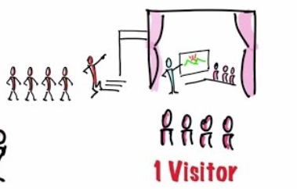
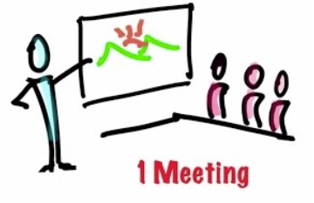


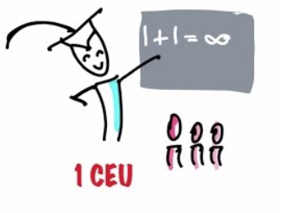
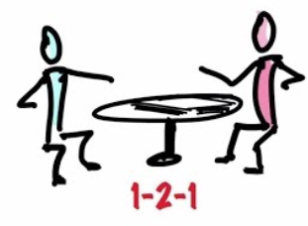
BNI Power of One

Slide 9
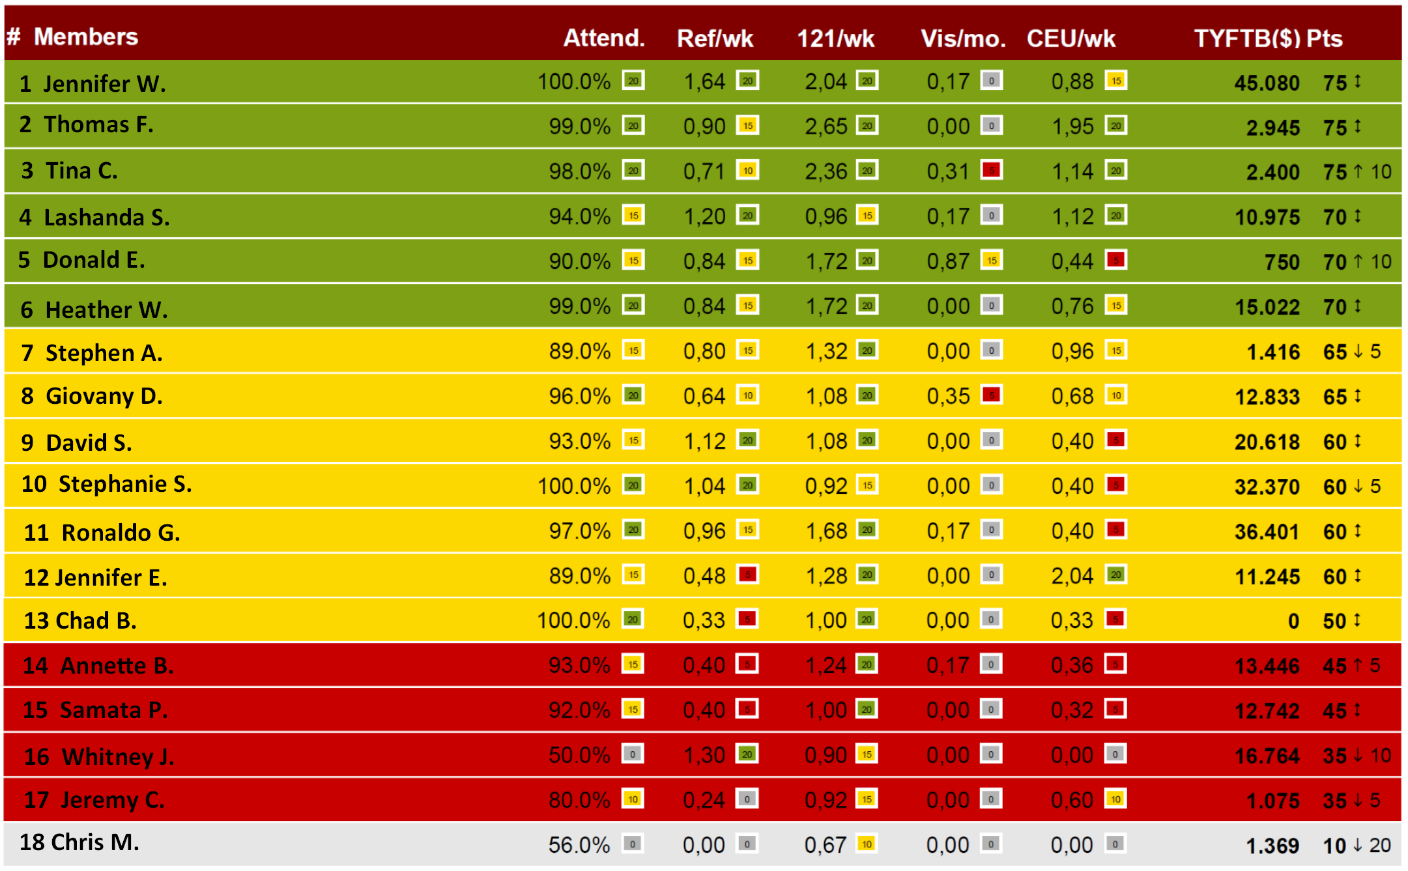
Member Traffic Lights Report

Slide 10
Why Member Success Program
Members Success Program helps new members profit from their BNI membership as early as possible with an introduction to our Key Success Factors and the set of skills required for maximum referral marketing success. It also provides a forum for cross chapter networking between new and experienced members.

Slide 11

What is in Passport To Success
My BNI Checklist.
BNI Core Value.
BNI Code of Ethics.
Essential Website/Apps.
List of mentors and topics to cover in mentor 1-2-1s
How to successfully invite/bring visitors.
How to ask for a referral

Slide 12
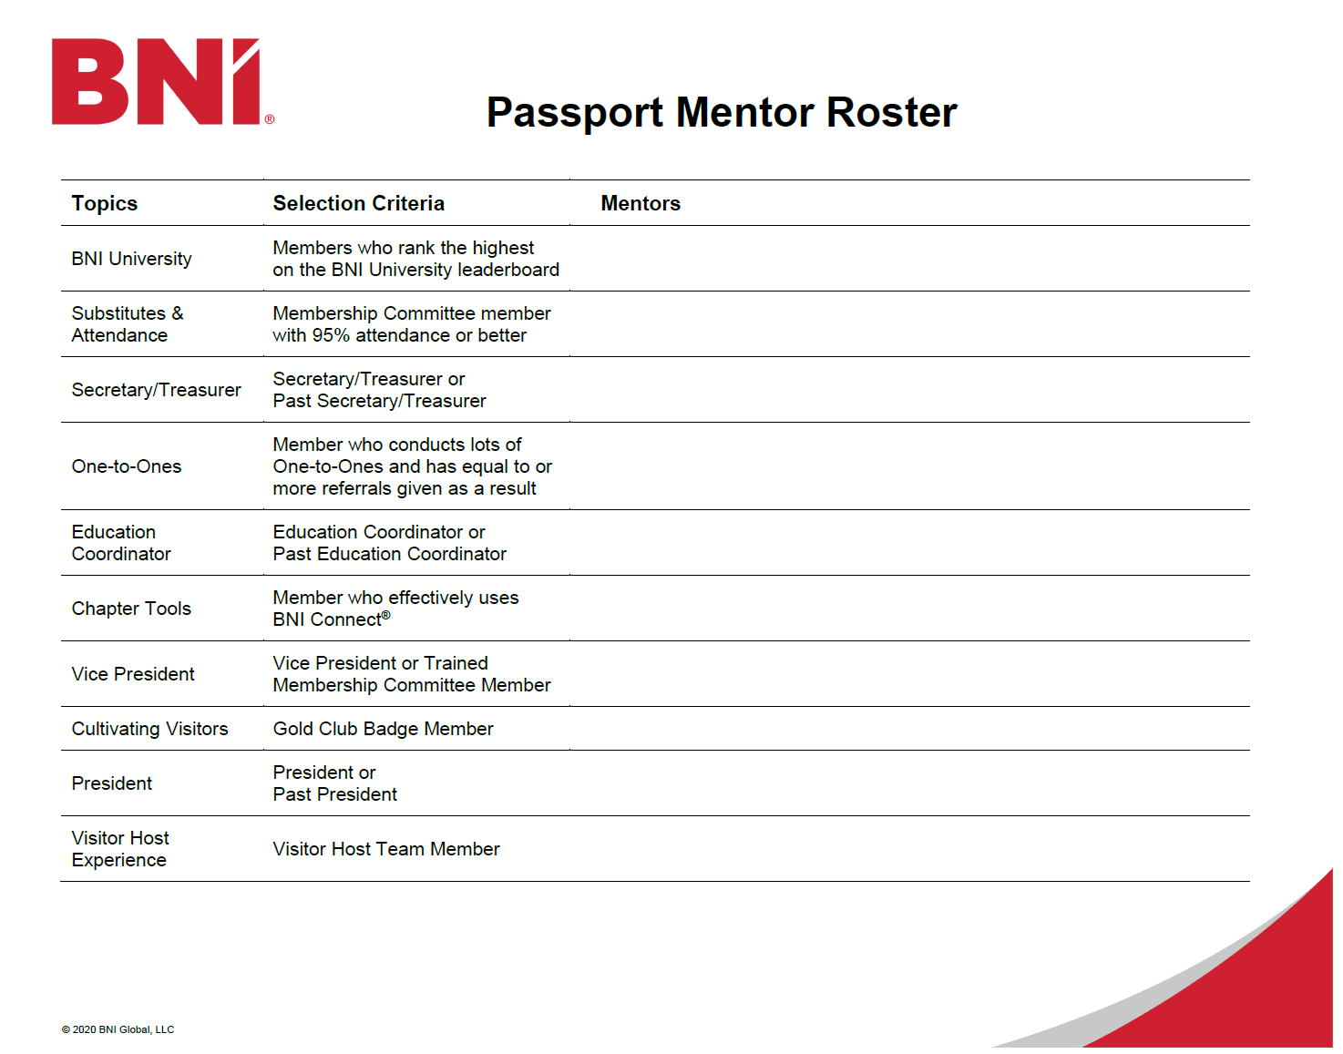

Slide 13
Mentoring Success Support
Member Success Program 2.0 completion in the first 30 days or less of membership
Smart Start Training completed in the first 60 days or less of membership
Passport completed in the first 90 days or less of membership
New member Training:
Much increased Power of One activity both new and existing members
Faster progress with and more 1-2-1s for new members
More BNI Business Builder Activity => more CEUs
Better weekly and feature presentations

Slide 14
Expectations prior to taking the role and in the role
Complete the Mentor Coordinator in person and online training prior to officially taking the role.
Show positive attitude and excitement to engage especially new members.
Lead by example.
Coordinate with Education Coordinators and other support team members
Have fun.

Slide 15
Any questions?

Slide 16

Workshop Objectives
In this workshop you will:
Create a mentor list for your chapter, using the Member Traffic Lights Report and Passport Mentor Roster.
Match members not meeting chapter expectations with a mentor using the Member Traffic Lights Report.

Slide 17
Create a Mentor List

Slide 18
Member Mentor #1 – President : President or former President
Discuss the Leadership Team roles
Review the BNI Weekly Meeting Agenda
Discuss the expectation that all members serve on the Leadership Team
Discuss weekly commitment that all members make
Notes:
‹#›

Slide 19
Member Mentor #2 – Vice-President: Vice-President or former Vice-President
Discuss the BNI Policies
Explain the PALMS Report and the Traffic Light Reports
Explain how to register email address with Reporting2you.com
Notes:
‹#›

Slide 20
Member Mentor #3 – Secretary Treasurer: Current or former Secretary Treasurer
Discuss completion of the Biography Sheet
Discuss attending the Member Success Program prior to conducting a Feature Presentation
Discuss how to pay chapter fees such as venue or breakfast fees, etc.
Discuss how to submit a membership renewal when the time comes.
Notes:
‹#›

Slide 21
Member Mentor #4 – Membership Committee:Current member of the Membership Committee
Explain the role of the Membership Committee
Cover the Substitute Program – Who to use and how to prepare them
Cover the Attendance Policy (General Policy #5)
Notes:
‹#›

Slide 22
Member Mentor #5 – Education Coordinator: Current or former Education Coordinator
Discuss the importance of referrals versus leads
Explain how to earn and record Chapter Education Units (CEUs)
Confirm if new member has access and knows how to access BNI Business Builder
Notes:
‹#›

Slide 23
Member Mentor #6 – 121 & GAINS: Use Mentor who does a high number of 1-2-1s
Discuss One-to-One etiquette using the GAINS Exchange
Discuss the One-to-One Meeting Planner
Notes:
‹#›

Slide 24
Member Mentor #7 – BNI Connect: Use Mentor who is great with BNI Tools
Explain how to use the BNI Connect App
Assist with enhancing their BNI Connect Member Profile
Explain how to record and track their activity in BNI Connect
Notes:
‹#›

Slide 25
Member Mentor #8 – Gold Club Badge: Use Mentor who brings a high number of visitors
Discuss importance of why and how to bring people to visit
Discuss how each guest/visitor adds value to the other members
Notes:
‹#›

Slide 26
Member Mentor #9 – Visitor Host Coordinator: Visitor Host Coordinator or part of the Visitor Host Team
Share that every new member will serve as a Visitor Host together with the Visitor Host Team during one meeting
Meet with the new member to discuss the date and task
Notes:
‹#›

Slide 27
Member Mentor #10 – Local Trainings: former Education Coordinator
Share details of upcoming local training's
Share details of upcoming local BNI events for additional networking opportunities
Show how to find and register for events on regional website
Explain the value of the BNI Regional Weekly Newsletter
Notes:
‹#›

Slide 28
BNISCI Passport Diamond Club

Slide 29
BNISCI Passport Diamond Club
When a BNISCI Member Sponsors another New Member within the first 90 days of their BNI Membership

Slide 30
BNISCI Passport Diamond Club
A BNI member that sponsors a new member in their first year of membership is 78% more likely to renew their membership
A BNI member that sponsors a new member after their first year of membership is 68% more likely to renew their membership
A BNI member that sponsors a new members in the first 90 day of membership is 82% more like to renew their membership
(Passport Diamond Club)

Slide 31
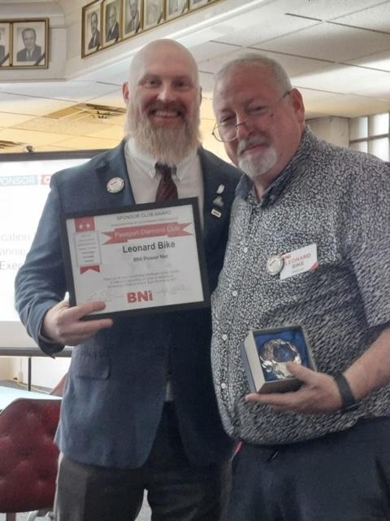
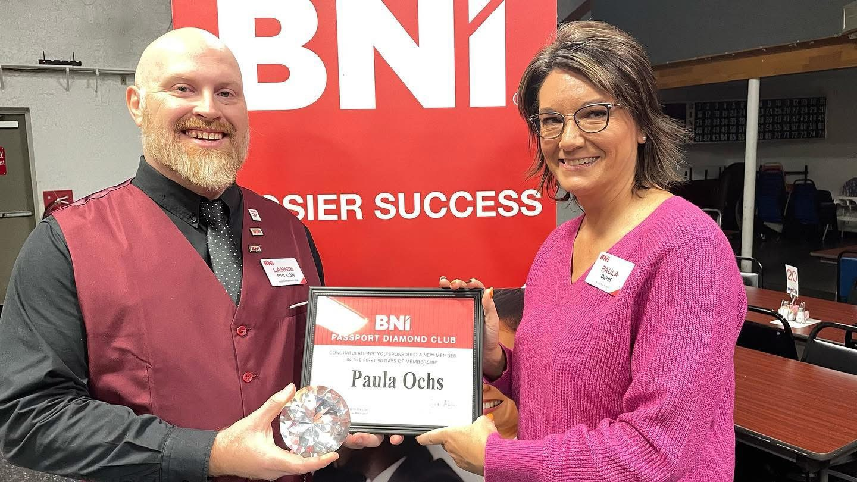
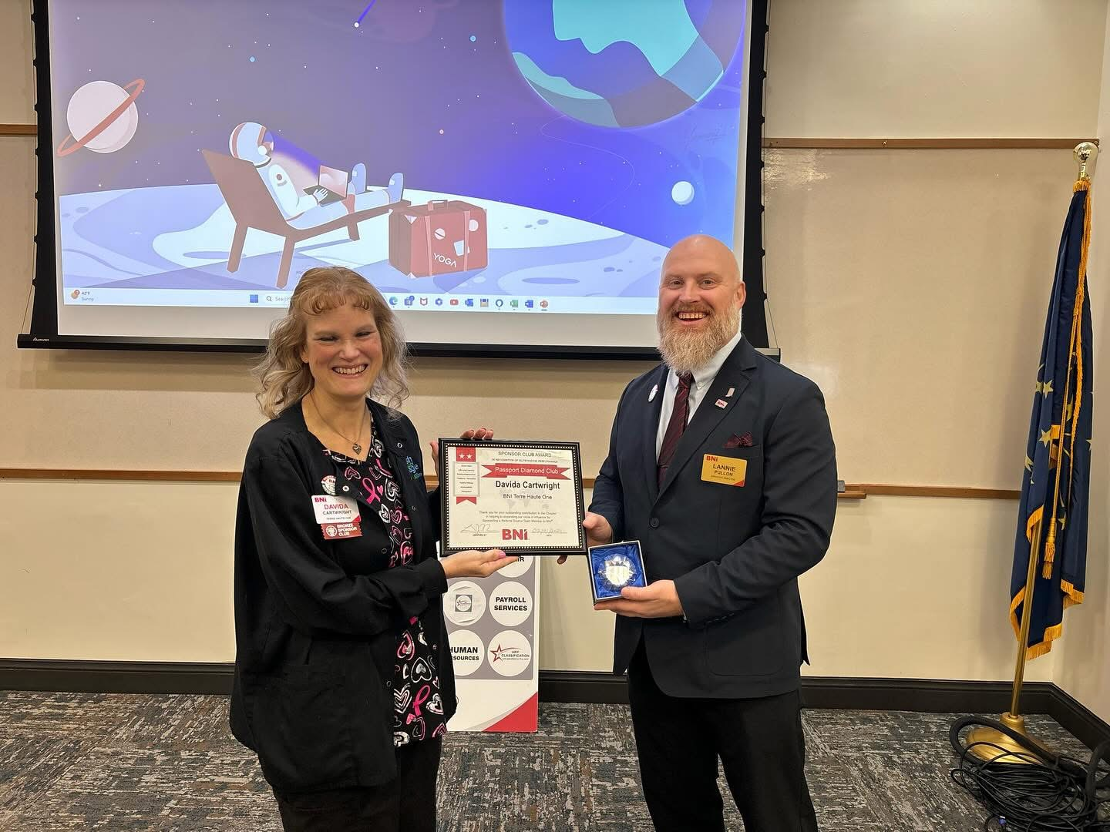
BNISCI Passport Diamond Club

Slide 32

Activity! My Mentor List
You Will Need:
Passport Mentor Roster => (10 member mentors)
Instructions:
Identify one mentors for each category within your chapter and document them within the Passport Mentor Roster.
Be prepared to share.
What Questions Do You Have?

Slide 33
10 member Mentor List
#1 - President
#2 - Vice President
#3 - Secretary / Treasurer
#4 -Membership Committee
#5 - Education Coordinator
#6 - One-to-One & GAINS
#7 - Chapter Tools
#8 - Gold Club Member
#9 - Visitor Host Coordinator
#10 - Local Trainings

Slide 34
Lesson 2:
Mentor for Performance

Slide 35

Challenges?

Slide 36

Initiating the Conversation

Slide 37

Work with Chapter Membership Committee
Instructions:
Review the Member Traffic Lights Report from.
Identify 3-5 members who are in need of mentoring and an appropriate mentor for each.
Make note of the mentor/mentee pairs in your Participant Guide.
Be prepared to share.
What Questions Do You Have?

Slide 38
Member Traffic Lights Report

Slide 39
INDUCTION FOR NEW MEMBERS
Celebration and Recognition on a new member’s first day
  Include the Mentor Coordinator
  Recognize the Sponsor
  New Member Bio
  Code of Ethics
  Passing of the Passport
  Social Media post in private FB group, public FB page
Mentor Coordinator arranges a meeting after the chapter meeting
Notes:
‹#›

Slide 40
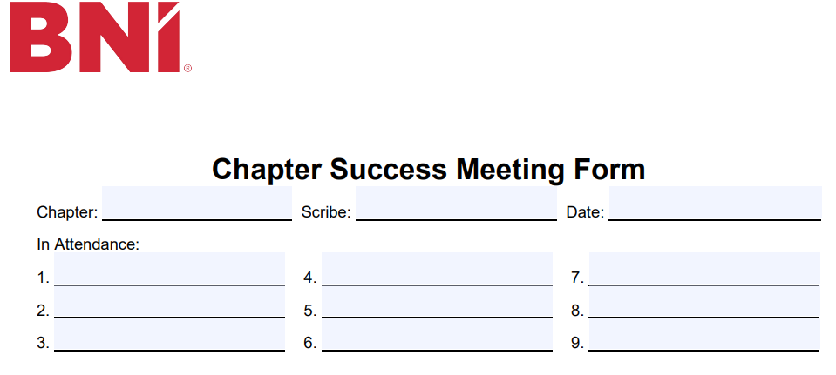
Chapter Success Meeting

Slide 41
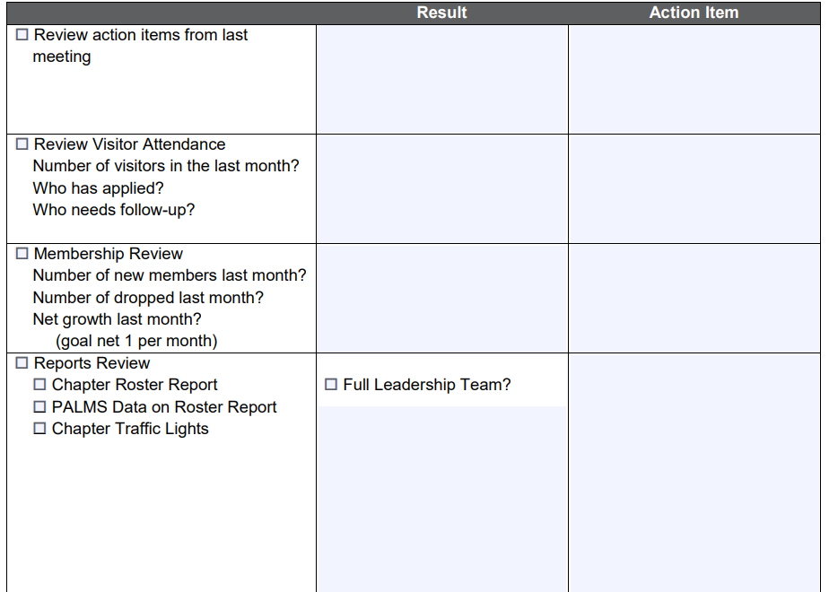
Chapter Success Meeting

Slide 42
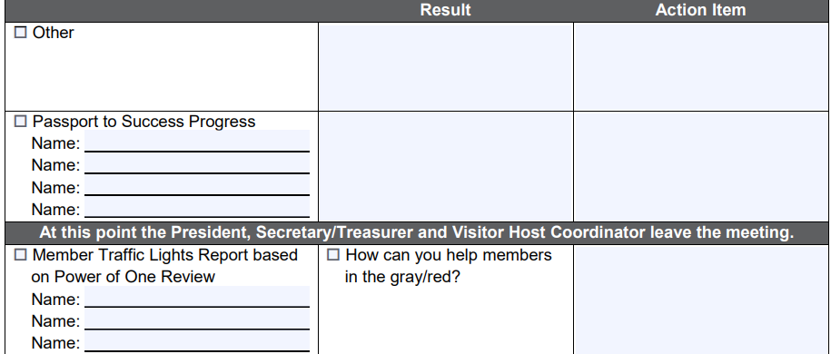
Chapter Success Meeting

Slide 43
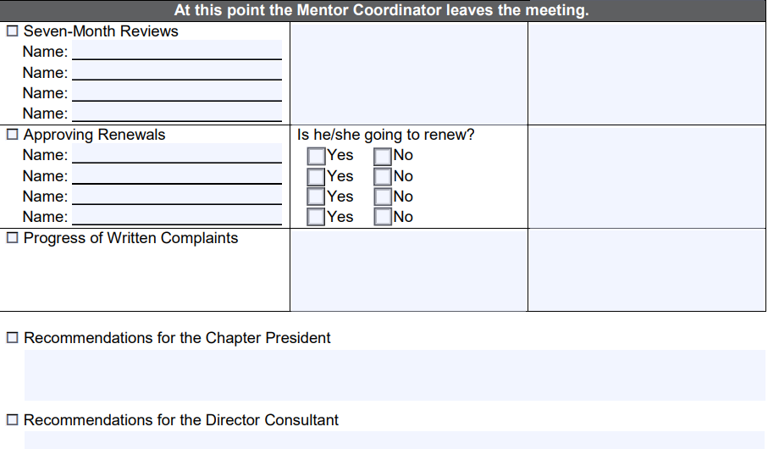
Chapter Success Meeting

Slide 44

PASSPORT GRADUATION

Slide 45
PASSPORT GRADUATION CELEBRATION
Passport Completion is a time to celebrate! Why?
Where in the Agenda
  Feature Presentation
  Notable Networker
  Announcements
Invite the Regional Support Team
Invite Visitors
Present a Certificate of Completion
Individual and Group Photos
Make it fun! Trivia quiz about the new member, Q&A interview-style

Slide 46
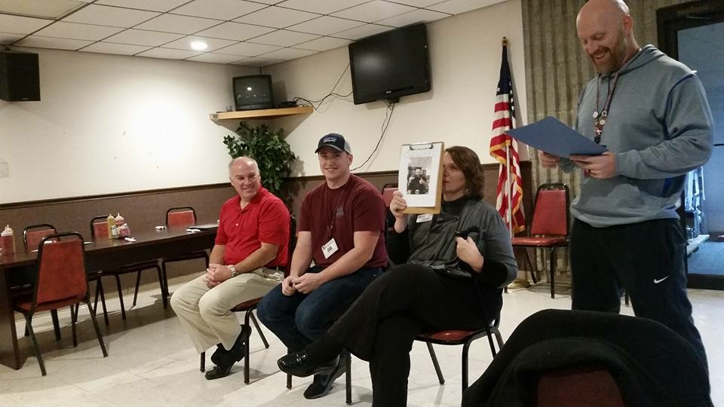
PASSPORT GRADUATION CELEBRATION

Slide 47
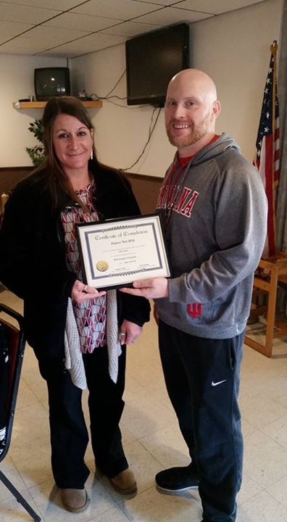
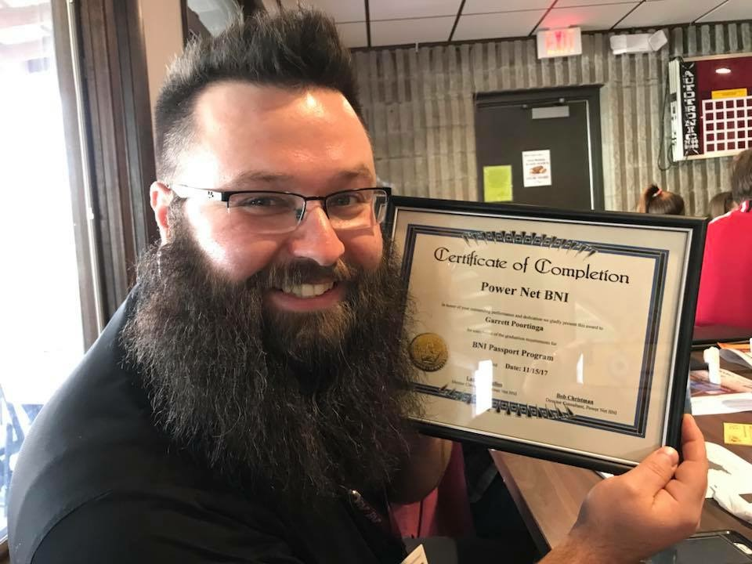
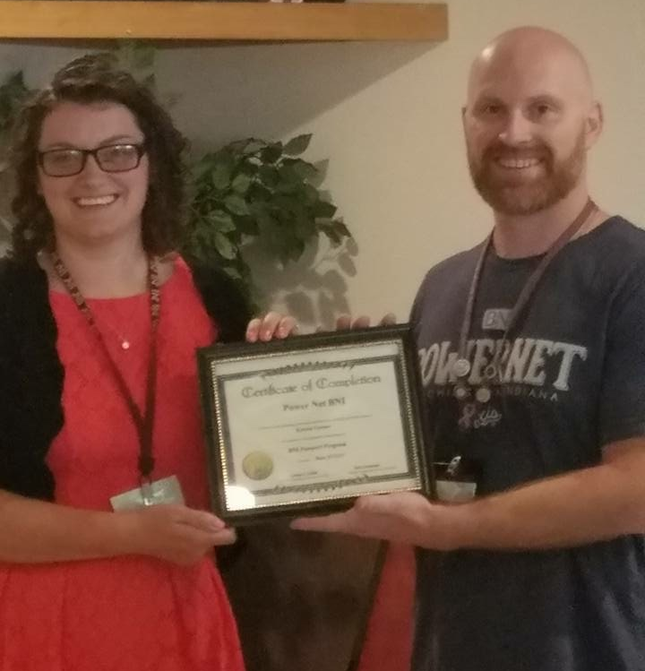
PASSPORT GRADUATION CELEBRATION

Slide 48
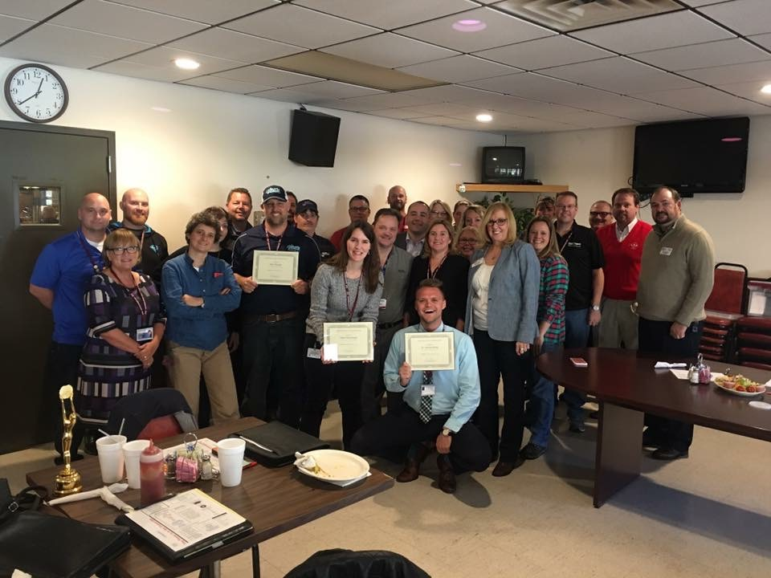
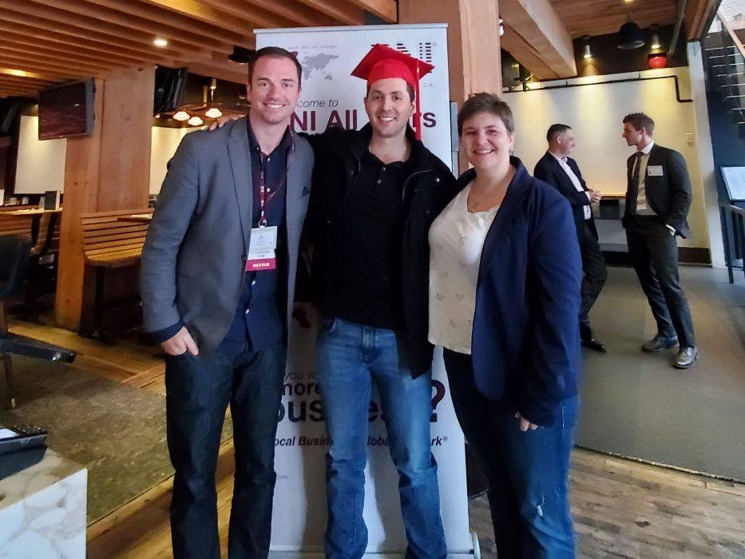
PASSPORT GRADUATION CELEBRATION

Slide 49
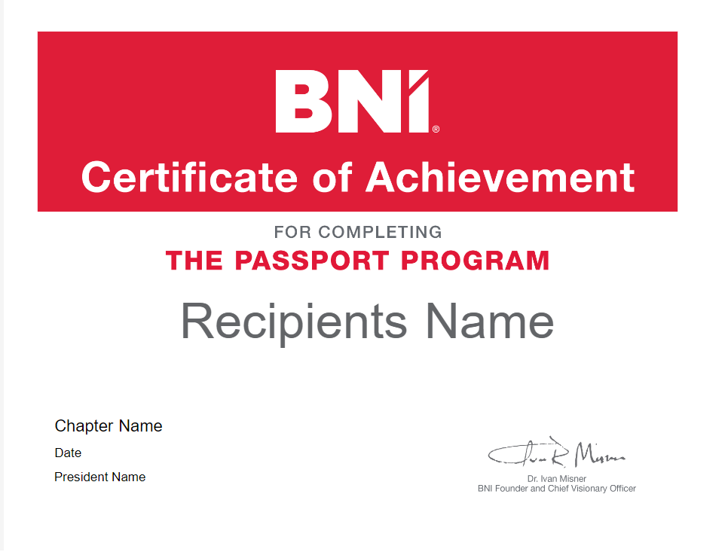
PASSPORT GRADUATION CERTIFICATE

Slide 50
Any Questions?

Slide 51

CEU

Slide 52
Thank you!

