Slide 1

Welcome to the
Leadership Team Orientation
Vice President & Membership Committee

Slide 2

Individual Compensation of $249.00
1) Attend 80% or better to BNISCI Roundtable
(sub count as attendance)
2) 80% or better Chapter Success Meeting report
turned in over the term year. To ED and chapter AD/DC
3) Chapter Grows by 25% from October 1, 2025 to
September 30, 2026.
If approved for compensation you will be
notified of next steps.

Slide 3
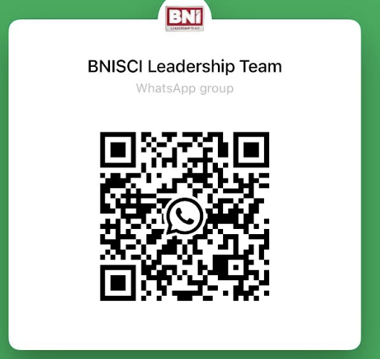
Leadership WhatsApp Page
President, Vice President, Secretary Treasurer

Slide 4

SPECIAL REQUEST!
When sending emails to the admin team please:
  In the subject line, please include your chapter name and member name (if needed).
  This will help us locate your chapter/member information faster and reply as quickly as possible. Also helps us when looking for an email.
When assisting new members with applications:
  Please review the category/classification list and help them choose the CORRECT seat!

Slide 5
BNIConnect: Reports (Outputs)
Reports | Chapter:
  Chapter Roster Report
  Membership Dues Report - renewals
  Summary PALMS Report - participation
  Personal PALMS Report – member, 7-month
  VP Report
  Chapter Visitor Report – CB Chair, Visitor Host
  Visitor Registration Report – VHC
  Visitor Not Attended Report – CB Chair, VHC

Slide 6
BNIConnect: Operations (Inputs)
Click Operations | Chapter:
  Manage Visitors – Visitor Host Coordinator
  Meeting Management
    Enter PALMS
  Manage Memberships
    View Pending Applications
      New Member Applications
      Renewing Members
  Manage Goals
  Create Email
  Manage News

Slide 7
Reporting2You.com: Reports
Chapter Reports:
  Chapter Level Traffic Lights (“MRGTL” report)
  Chapter KPI Report
  Chapter Performance Report
Member Reports (shows Member level):
  Member Evolution Report
  Member Monthly Report
  Weekly Alert Report

Slide 8
Vice President Chapter Expectations
1
Arrive at meetings 15 minutes before Open Networking to set up the room. Step in to run the weekly Chapter meeting when the president is absent.
2
Enter the PALMS Report into BNI Connect® the same day as the chapter meeting. Using data from BNI Connect®, update the Chapter Goals.
3
Effectively manage and be an active voting member of the Membership Committee.
4
Respond to communication from your Director and the BNI® Region Office in a timely manner.
5
Communicate and cooperate with the chapter President, Director Consultant, BNI® National Office and the BNI® Regional Office in their pursuits to improve and maintain the quality of your chapter.

Slide 9
Vice President Chapter Expectations
6
Chair and manages the Membership Committee including working with the MC to develop and implement the Goal Plan during the term.
7
Conduct brief weekly Membership Committee check-ins after each meeting to review applications in progress and address immediate member issues.
8
Designate Membership Committee member to give the weekly MC report on new/renewal applications & targeted Chapter classifications.
9
Protect the Membership Committee and keep those decisions and discussions private.
10
Ensure that the Membership Committee consists of trained Membership Committee members at all times. Ensure the Membership Committee Specialists are fulfilling their responsibilities.

Slide 10
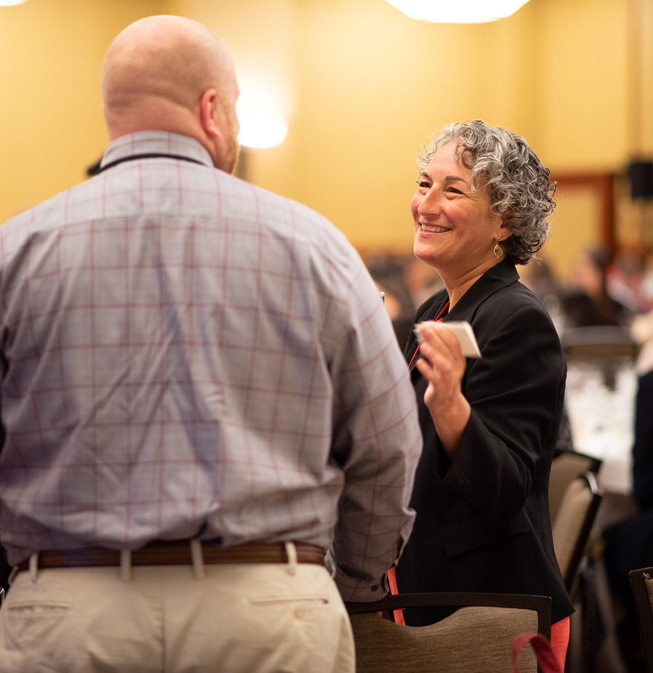


RESPONSIBILITIES
Prior to the Meeting
Courtesy of Mike & Jenn Photography

Slide 11
What Should we be Doing Before?
Prepare for a successful meeting
  Have Chapter statistics available to report to chapter during Vice President’s Report
  Print blank PALMS Report from BNI Connect® prior to each meeting for recording PALMS data at meeting
  Assign Membership Committee member to give a complete Monthly Membership Committee Report
Participate on the Monthly Chapter Success Meeting with the rest of Leadership & Director Team
Arrive to the meeting 15 minutes before Open Networking
Display Chapter Goal
Ensure all Membership Committee Specialists can fulfill this week’s responsibilities. If not, re-assign or ensure tasks get completed.

Slide 12
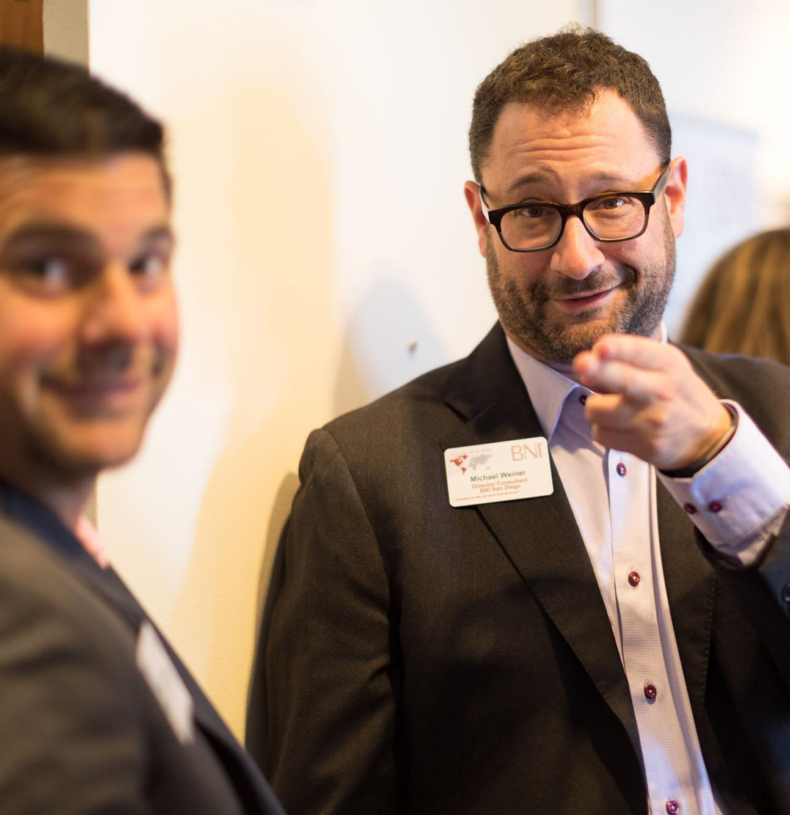
RESPONSIBILITIES
During the Meeting
Courtesy of Mike & Jenn Photography

Slide 13
What Should we be Doing During?
Run the BNI® Weekly Chapter Meeting Agenda if President is absent
Provide a complete Vice President’s Report of Chapter Goals (keep it positive)
Record attendance and notify the Community Builder Specialist of any attendance issues
Inform members to submit all slips prior to the end of the
meeting to get credit on the following week’s report.

Slide 14
What Should we be Doing After?
Verify visitors to the chapter using the Visitor Portal in BNI Connect® prior to entering the PALMS Report.
Enter chapter statistics using the PALMS Report in BNI Connect®
on the same day after the meeting. Must be completed by end of that days meeting.
  The slips entered in BNI Connect correlate with the meeting time, NOT when the Vice President submits the report.
  If a member submits a slip before the meeting, then it will show up on that week's PALMS Report. This means that the numbers will show up on the following week's Vice President Report/Goals.
  if the member doesn’t submit a slip until after the meeting, it
  won't show up on the report until the following week.

Slide 15
After the Meeting
Conduct a brief Membership Committee Check-in
Ensure Community Builder is reaching out to any members that have 2+ Absences based on the PALMS statistics.
Inform Quality Assurance Specialist of any changes in membership in the chapter on your chapter’s roster/Membership Dues report.
Ensure Quality Assurance Specialist:
  Reviews new Membership Applications submitted
  Blind Copy email membership committee of applications/seats submitted for
  Assign responsibilities to Membership Committee members using the Application Processing Chart
  Assigns a completion date and conference call to discuss and vote
Notes:
For some reason there is a rumor going around that slips can keep coming up until the last second that a Vice President submits the PALMS Report. This is a false rumor, and it is not what we trained everyone, but still this thought process persists with a few VPs that were trained that rumor by his/her predecessor.

Slide 16
AS NEEDED & MONTHLY RESPONSIBILITIES
Conduct One-to-Ones with new members as part of the Passport to Success Mentor Program
Prepare Member Traffic Lights Report for Referral Partners in your Chapter and distribute the first week of the month (could be the 2nd week if the reports have not been delivered) and discuss the status of the Chapter (more Members in the GREEN from last month, percentage of Members in colors, how are we going to “RISE UP", recognize those Members who have made significant positive changes…)
Approve/Decline New Members in BNI Connect® upon
voted approval of the membership committee.

Slide 17
AS NEEDED & MONTHLY RESPONSIBILITIES
Reward members using the Notable Networker Certificates or other awards monthly
Approve/Decline Pending Renewals in BNI Connect® (Operations >> Manage Memberships >> View Pending Applications).
Track the Member/s leave early/comes late to meetings as needed.
Co-Chair monthly Chapter Success Meetings
Meet monthly w/ President & Education Coordinator to discuss the monthly Goal Plan Activities (End of Month)

Slide 18
Meeting Agenda

Slide 19
Meeting Agenda
Open Networking
Welcome Visitors and Introduce Leadership Team, Membership Committee, Visitor Hosts, Education Coordinator, Event Coordinator, Growth Coordinator and Mentor Coordinator
Purpose and Overview of BNI®
Networking Education
Announce BNI® Network Leaders (MONTHLY)
Welcome New and/or Renewing Members to the Organization (AS NEEDED)
Members Introduce Themselves and Give their Weekly Presentation
Welcome Visitors to BNI® and Have Members Introduce Them
Vice President’s Report (WEEKLY)
Membership Committee Report (WEEKLY or Assign to MC Member)
Secretary/Treasurer Announces Speaker Rotation
Speaker(s) Give 5-12 Minute Feature Presentation(s), Including Questions and Answers
Referrals and Testimonials
Secretary/Treasurer’s Report
President Thanks Visitors
BNI® Announcements, Reminders and Special Reports

Slide 20
Presentation Slides
Needing updates Weekly and Monthly (in order on presentation)
(Monthly) Notable Networker Awards.
(Weekly) PALMS report / GOAL Boards.
(As Needed) Membership Committee report - Target professions and applications in progress.

Slide 21
BNI Connect - Operations
Manage Visitors (marking visitor attendance):
Operations > Manage Visitors > Visitor Registration & Attendance Portal
Meeting Management (PALMS Report):
Operations > Meeting Management > View or Enter PALMS
  View PALMS
  Enter PALMS
Manage Memberships (New & Renewing Members):
Operations > Manage Memberships > View Pending Applications
Manage Goals (Editing & Viewing Chapter Goals):
Editing: Operations > Manage Goals > Enter Chapter Goals
Viewing: Operations > Manage Goals > Enter Chapter Goals

Slide 22
BNI Connect - Reports
Chapter Roster Report (List of Members):
Reports > Chapter Roster Report
Membership Dues Report (Renewals):
Reports > Membership Dues Report
Summary PALMS Report (PALMS Full Chapter Info):
Reports > Summary PALMS Report
Personal PALMS Report (PALMS Individual Member Info):
Reports > Personal PALMS Report

Slide 23
Reporting2You Reports
Received by the 5th Day of the month

Slide 24
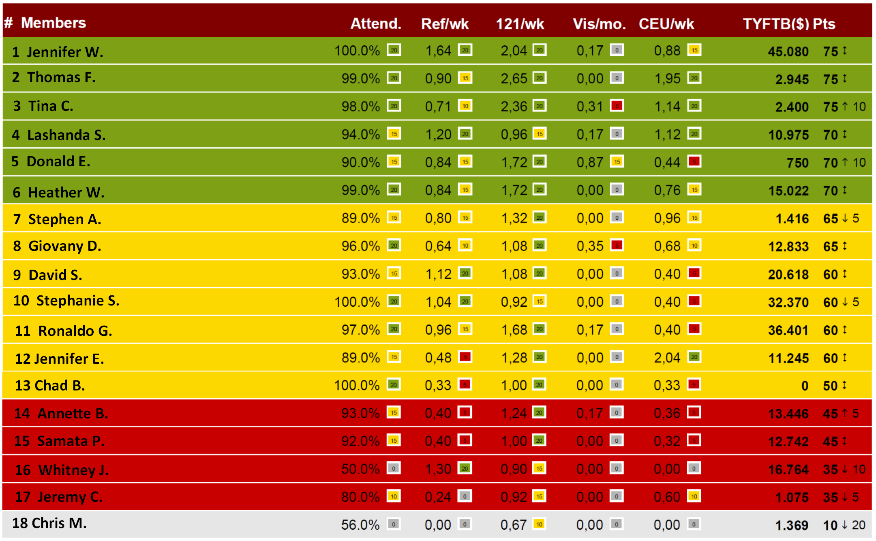

Slide 25
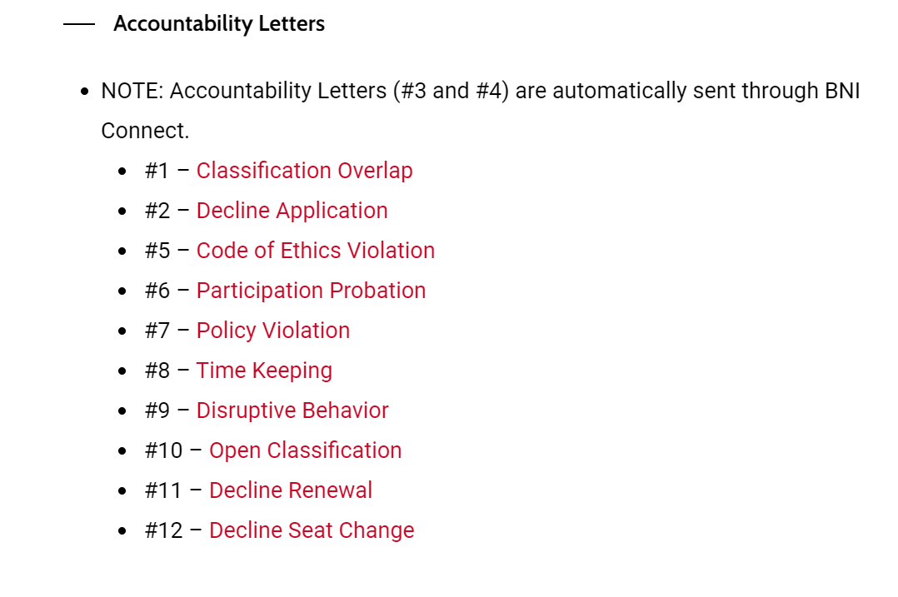

Slide 26
Notable Networker Award
1
The networking is what we are rewarding, not the award itself.
2
Make the presentation one that encourages more of the same behavior.
3
One suggestion - review top three for each category.

Slide 27
Membership Committee Meeting
Running the Meeting

Slide 28
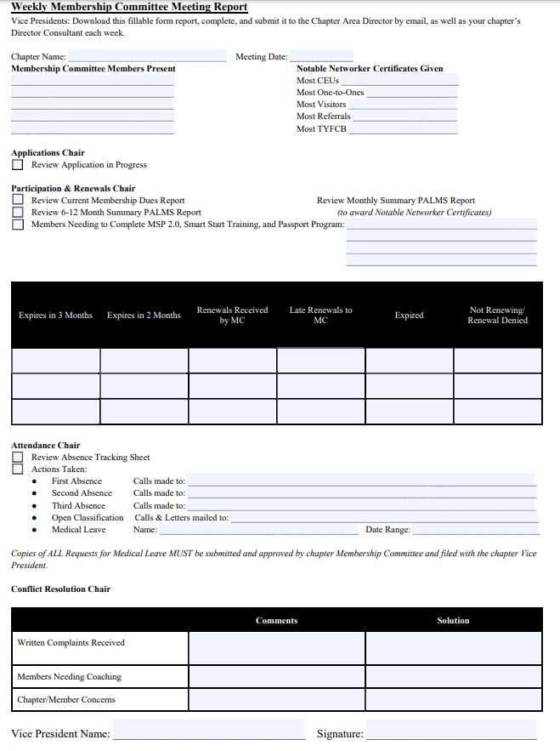
Weekly Membership Committee

Slide 29

New Member Applications

Slide 30

Starting October 1, 2025

Slide 31
10 Day Application
Pat DeVliegher

Slide 32
10 Day Application
What’s New?
“Apply and Pay” for New Members
In addition to being able to enter a new application online, the chapter will have a unique QR code to access BNI Connect or the mobile app. Applicants will be directed to make their payment immediately.
To ensure the application is processed by the VP and Membership Committee in a timely manner, the applications with payment will be “auto-approved” in 10 days.

Slide 33
Multiple Application/Hot Seats
Mortgage Lender
P&C Insurance
Residential Realtor
Financial Advisor
All other seat must a approved by Lannie Pullon

Slide 34
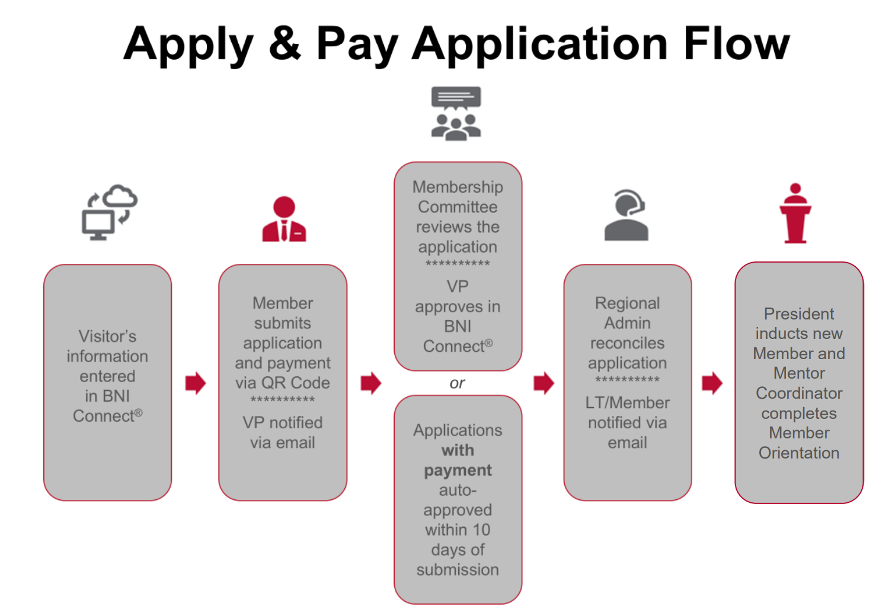

Slide 35
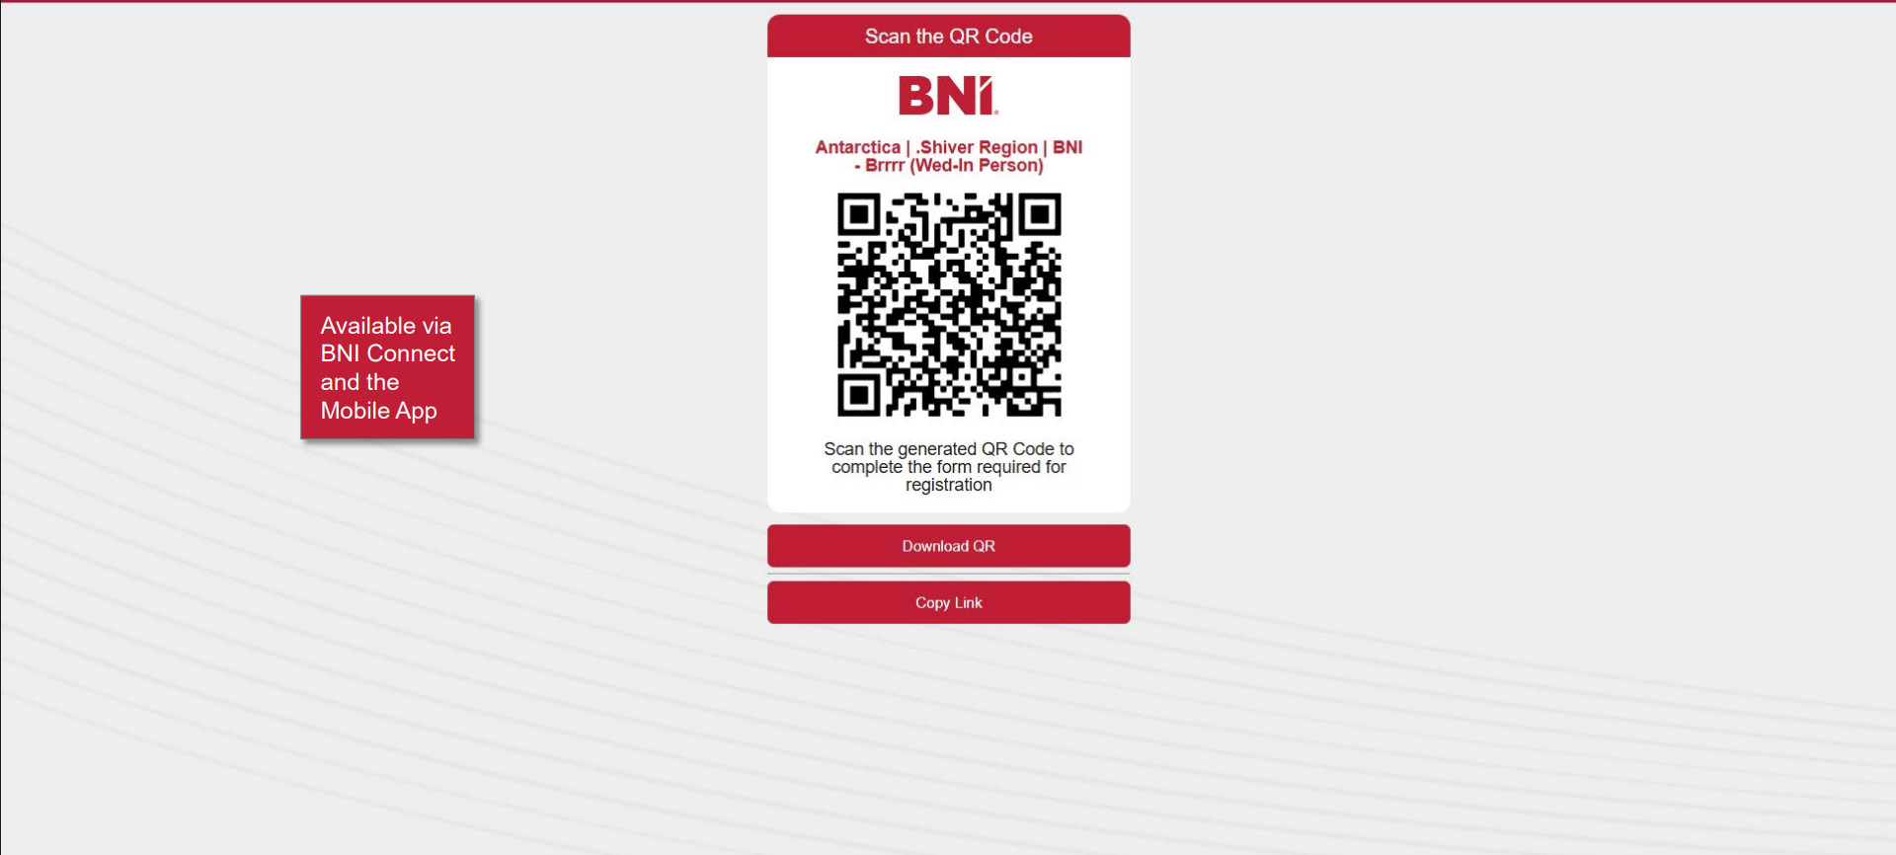

Slide 36
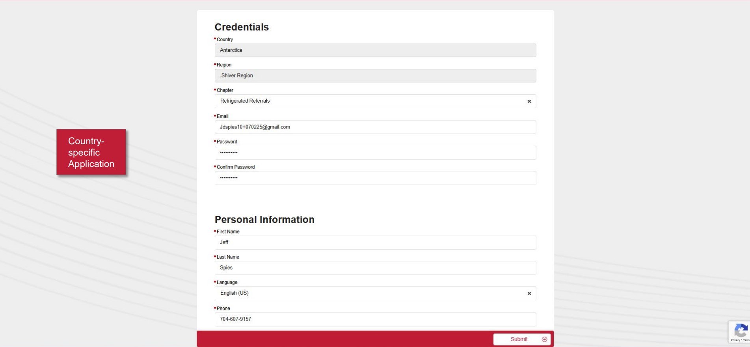

Slide 37
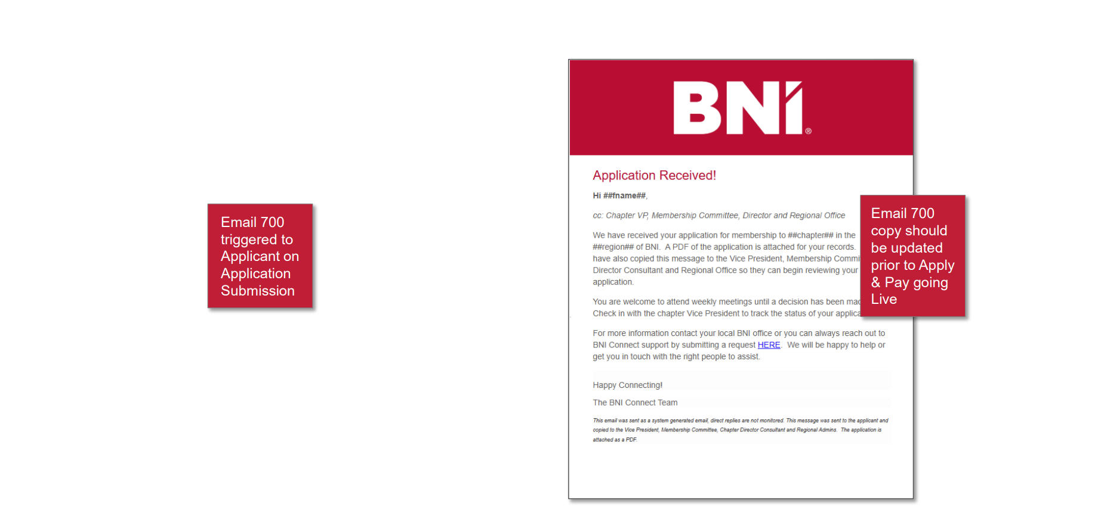

Slide 38
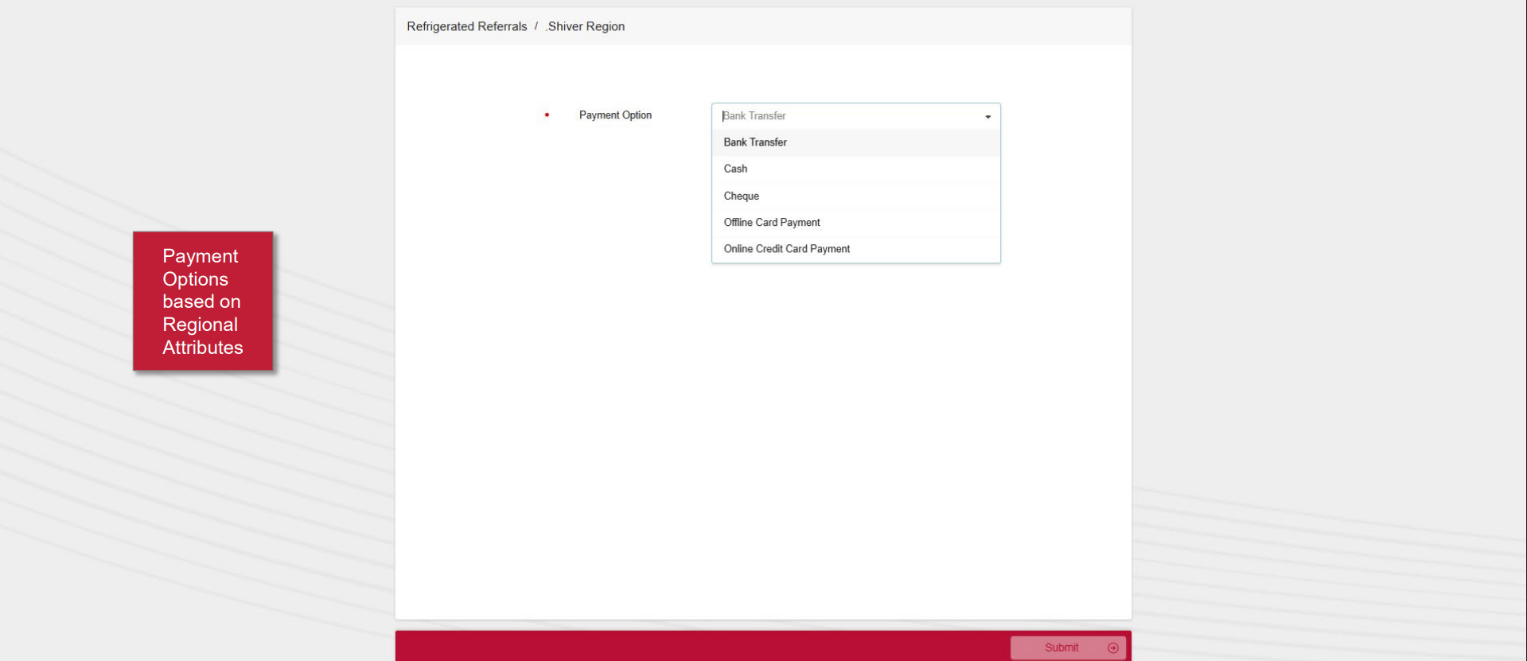

Slide 39
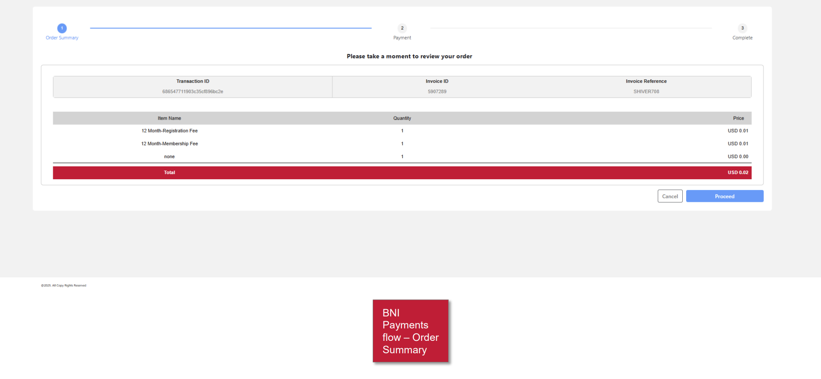

Slide 40
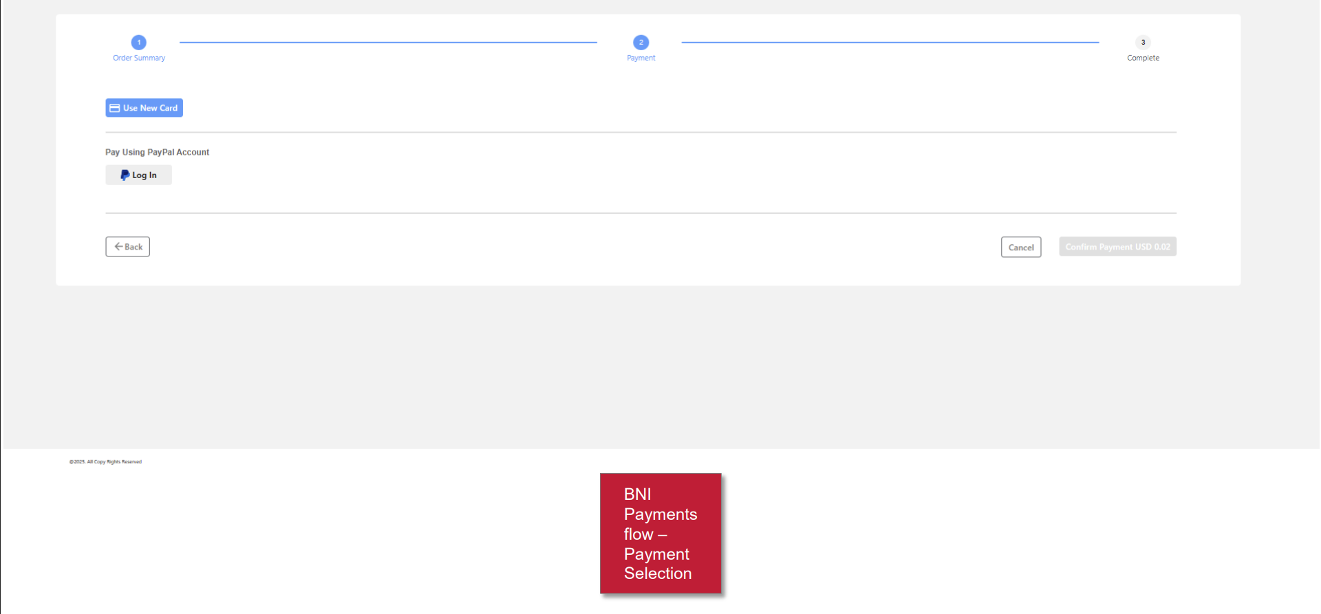

Slide 41
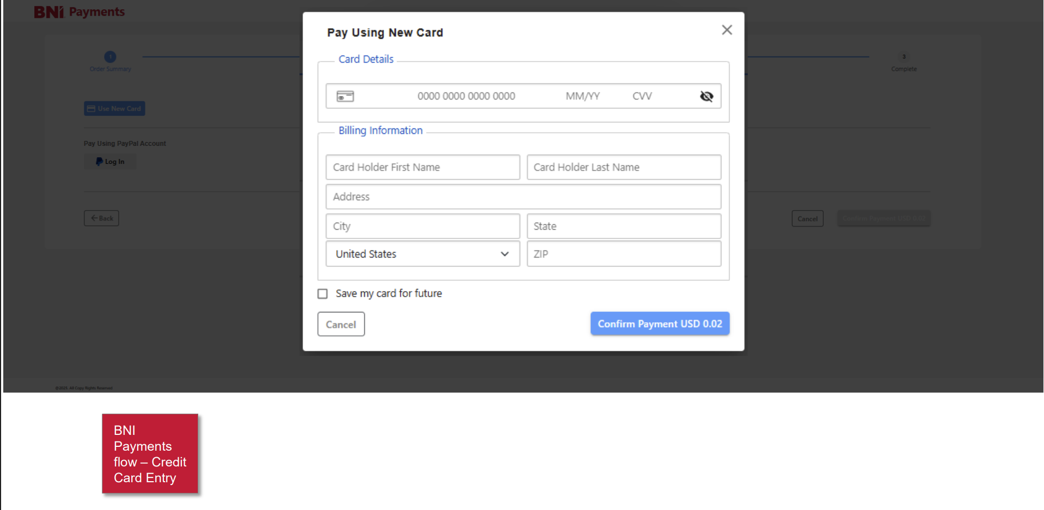

Slide 42
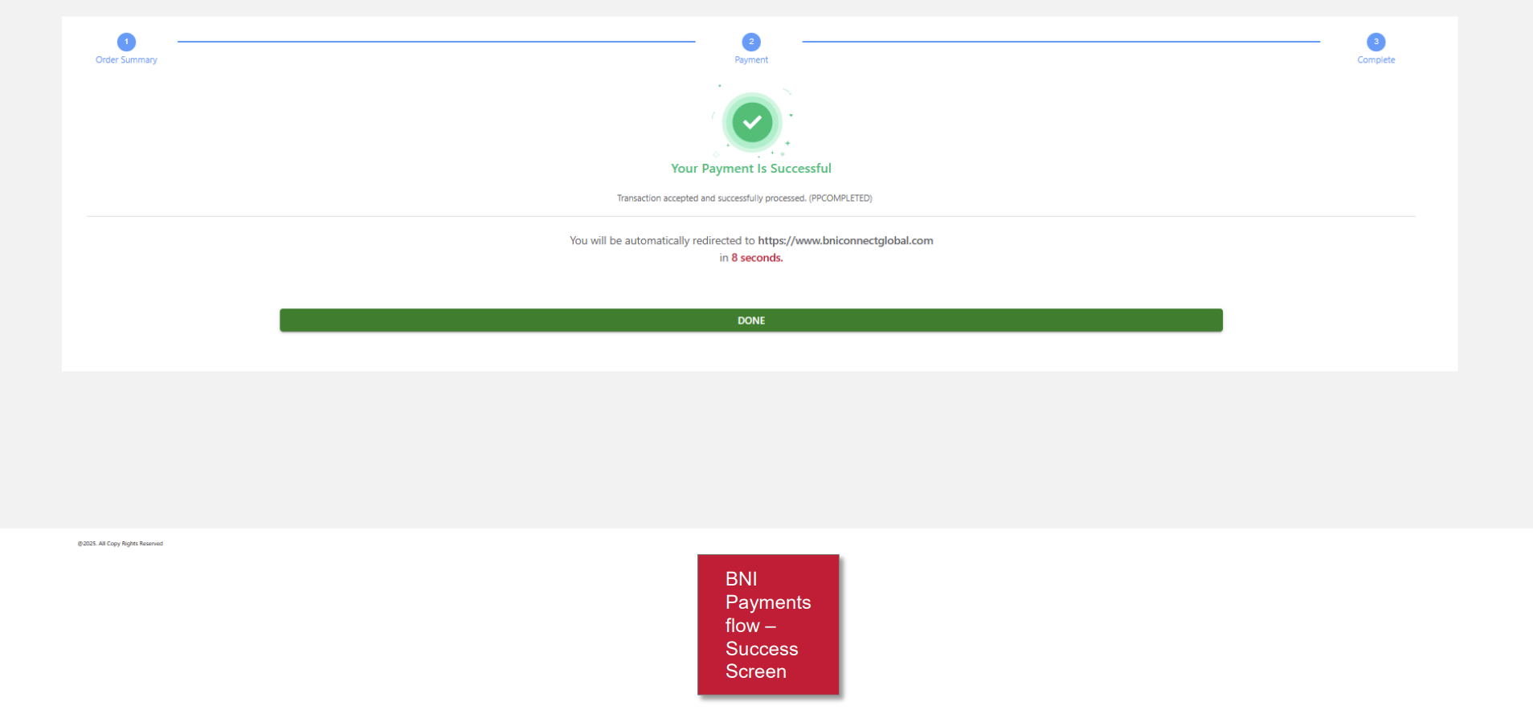

Slide 43
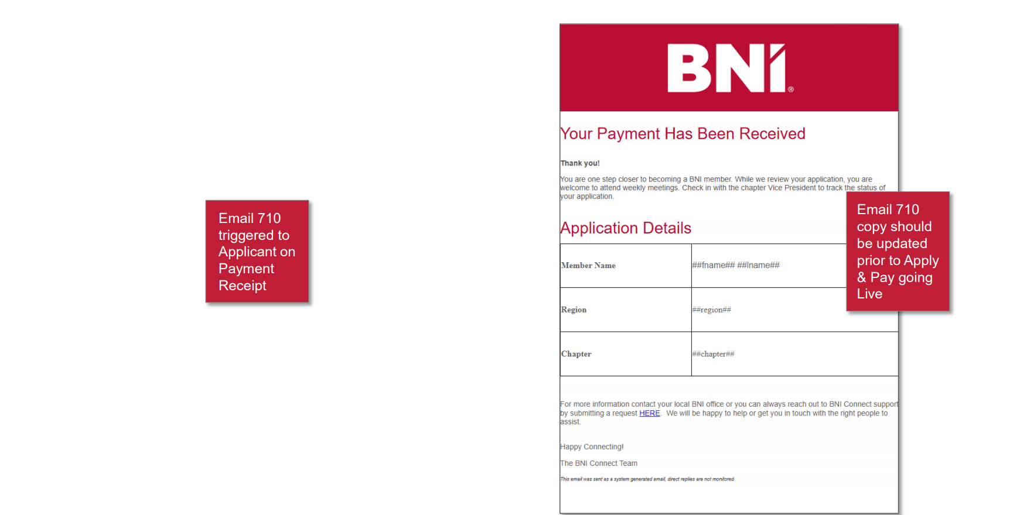

Slide 44
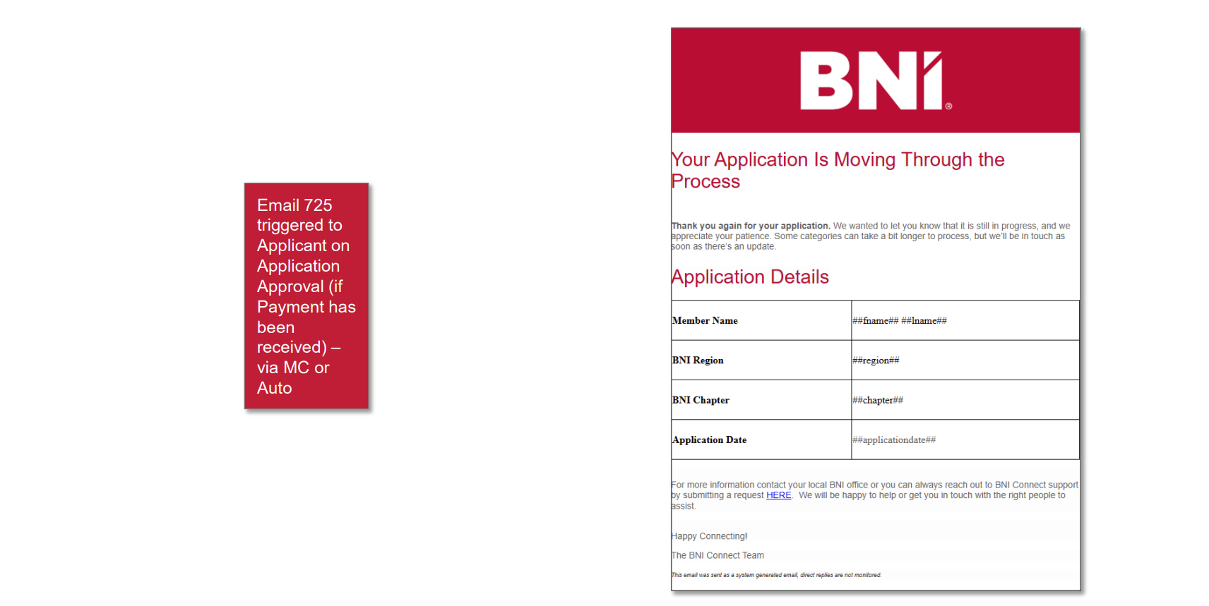

Slide 45
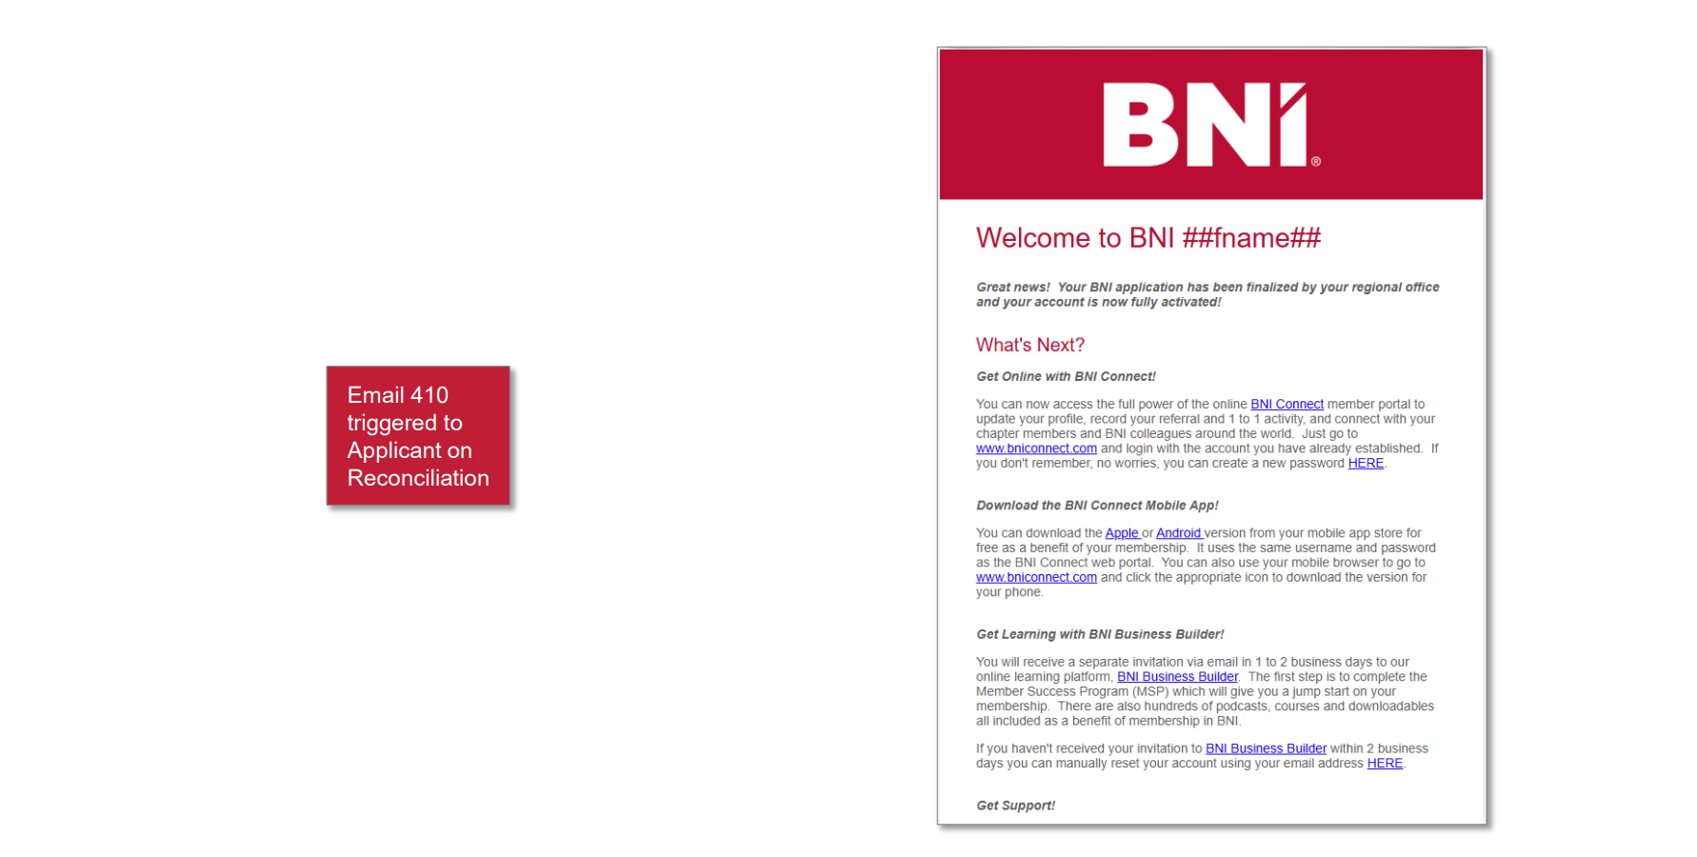

Slide 46
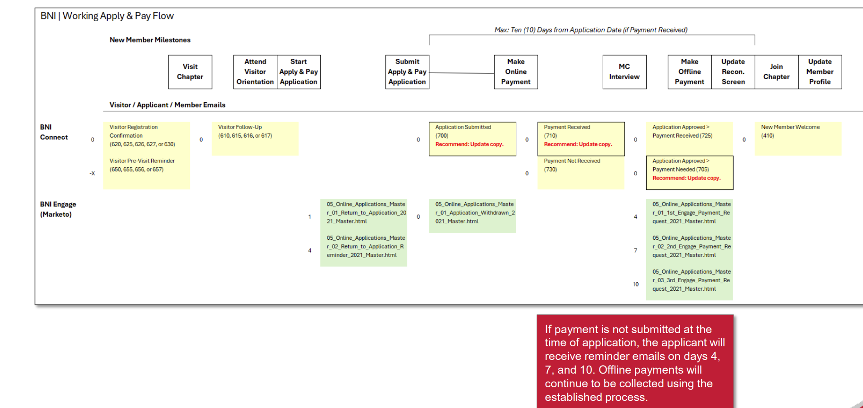

Slide 47
The Perfect Online New Member Application
Visitor Submits Application
1 Day Post Submission
Within 7 days VP Approves Application
Applicant immediately receives an email with a copy of the application
VP and DC receive an announcement that an app is pending and needs approval
Notice is immediately sent to applicant to proceed to payment
Within 2 days Applicant Pays
Application Reconciled by Regional Office
Member immediately receives welcome email
All chapter roles and DC receive notice of new member 1 day later, President receives induction alert email
Confirmation of payment sent to applicant
Confirmation of payment selection sent to P, VP, ST, DC, RA

Slide 48
Oh no! Application Incomplete!
1 Day Post Submission
Applicant receives a reminder to continue the app
VP receives a notice that there is a partial app submitted
Visitor Starts an online application but doesn’t finish it
13 Days Post Submission
Regional Admin notified of partial app that can be voided
4 Days Post Submission
Applicant gets 2nd reminder to complete the application

Slide 49
Application Complete, but Needs Approval
1 Day Post Submission
8 Days Post Submission
Visitor Successfully Submits an Online Application
VP and DC receive an announcement that an app is pending and needs approval
VP receives 2nd notice to approve the application
16 Days Post Submission
13 Days Post Submission
15 Days Post Submission
Submitted
online application is deleted
VP receives 3rd notice DC receives 1st notice
VP receives 4th notice

Slide 50
Application Status
Draft Application – Needs Review
Applicant bailed and needs to complete the app. If abandoned needs to be voided by Regional Admin
Application Submitted – Needs Review
Applicant finished the app and now it needs VP\MC approval
Payment Selected – Approved
Payment method chosen but Regional Admin needs to verify and reconcile
Application Submitted – Approved
Ready for payment from Applicant. Regional Admin may send payment reminder.

Slide 51
The Applicant
Interview Process

Slide 52
Paper Applications are not accepted,
without exception.

Slide 53
Online New Member Interview

Slide 54
Why online new member interviews?
Can interview applicant faster
Less intimidating for the applicant
Have more membership committee members on the interview
Voting happens faster

Slide 55
FAQ?
How do chapter members get notified
of a New Member application?
Chapter starts a WhatsApp group for the chapter.

Slide 56
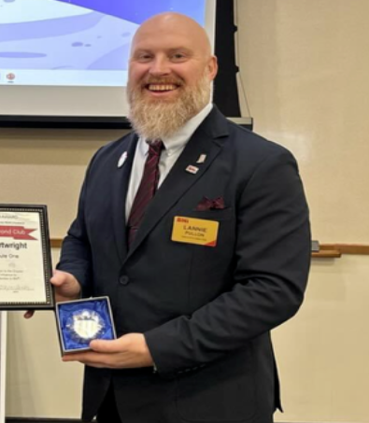
Interviewer Introduction
Lannie Pullon - Membership Committee
member of the Big Hoosier Chapter.
• 13 years in BNI
• 18 years as a fitness coach
• In 2020 I was BNI South Central Indiana
Member of the year
I love helping people make the right connections that lead to greater success for all.

Slide 57
Moving Forward
This interview is extended only to those who have submitted an application and are prepared, upon approval, to move forward with membership in BNI. It is not intended to be an additional step in one’s exploration of BNI.

Slide 58

Moving Forward
Should your application be accepted, are you prepared to move forward with your membership right away by submitting your payment within 24 hours of approval?

Slide 59
What to Expect in this Interview
The interview will last approximately 40 – 50 minutes.
We will clarify the commitments surrounding Member Engagement.
Together, we’ll determine if we’re a good fit for each other.
Don’t hesitate to ask questions.

Slide 60
Why?
Please share why you decided to apply for membership in BNI.

Slide 61
The Power of One
In BNI we measure Member engagement using something we call The POWER OF ONE:
1. ONE Meeting per week.
2. ONE Referral per week.
3. ONE One-to-One with a fellow BNI Member per
week.
4. ONE CEU per week (1 Hour of BNI Education)
5. ONE Visitor brought to your BNI meeting per
month.

Slide 62
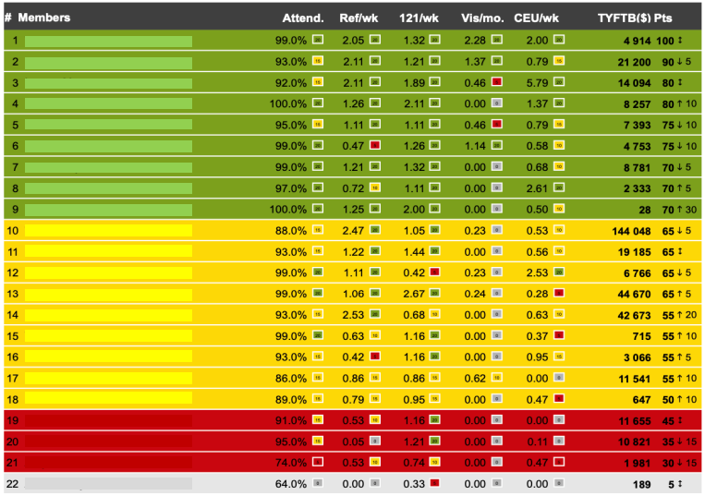
The Power of One

Slide 63
Engagement: The Power of One
When a BNI Member is fully engaged and in alignment with the POWER OF ONE they are listed as GREEN on the POWER OF ONE Report.
The following questions are to help clarify your understanding and commitment to being fully engaged as a Member of our BNI Chapter.

Slide 64
Referrals
The average BNI Member in our region passes approximately 52 referrals per year, which is about one per week. This also happens to be the standard for being green on the Power of One Report.

Slide 65
Referrals
What is your confidence level in your ability pass referrals regularly and your commitment to do so?

Slide 66
Referral Quality
While “Thank You For Closed Business” does NOT impact your ranking on the Power of One Report, it is a barometer for the quality of the referrals you pass.

Slide 67
Referral Quality
Please share your commitment to pass only qualified referrals who have requested to be connected with your fellow BNI Member.

Slide 68
One-to-Ones
A significant part of your BNI membership is the One-to-One meetings we hold with our fellow Members on a regular basis outside of the normal meeting.

Slide 69
One-to-Ones
One-to-Ones are more than a casual visit. There is an agenda and structure to these meetings. The Power of One standard is one One-to-One per week (52 each year), with the ultimate goal of meeting with every Member of your chapter at least once per year.

Slide 70
One-to-Ones
Please share your understanding and commitment to hold these critical One-to-One meetings with your fellow Members.

Slide 71
CEUs
BNI is built on a foundation of education. BNI Members are encouraged to engage in BNI specific education on a regular basis in the form of CEUs (Chapter Education Units). One CEU is awarded for each hour of BNI specific education completed. The Power of One standard for CEUs is one per week.

Slide 72
CEUs
Please share your view on the importance of this kind of education and your commitment to engage in the CEU program.

Slide 73
Attendance
One thing that sets BNI apart is its
Members’ commitment to attendance.
First, let’s clarify the goal…

Slide 74
Attendance
The BNI attendance policy allows for up to three absences in a rolling 26-week (6-month) period. As absences age they eventually drop off, bringing down the total number on record for the current 26-week period.

Slide 75
Attendance
You are not considered absent if you have a qualified substitute at the meeting on your behalf. This should be someone who knows you well and can vouch for you and your business (happy client, colleague, employee, friend, neighbor, or family member).

Slide 76
Attendance
NOTE: Having a substitute does NOT bring the same value to you or the Chapter, and should be a rare occurrence. Substitutes have not completed the same vetting process as a Member. Subs have not completed Member training, nor have they made the same public commitment to their fellow Members to pass referrals and honor the BNI Code of Ethics. Having a sub is not the same as having you.

Slide 77
Attendance
Please share your commitment to be on time, stay the whole time, and be an engaged Member in alignment with the BNI Attendance Policy.

Slide 78
Meeting Location
Megaplex Theater Vineyard,
Wednesdays,
9:30 AM
Meeting last for 90 minutes

Slide 79
Visitors
The Power of One standard for Visitors brought by a Member in established Chapters is one per month.

Slide 80
Visitors
In any BNI Chapter, growth is the key to achieving more referrals. As such, the goal is for each Member to bring at least one Visitor for an open category to each meeting.

Slide 81
Visitors
Please share your view on the importance of adding new referral partners to our group.
Please share your commitment to actively invite and register Visitors for our BNI meetings.

Slide 82
Your BNI Classification
BNI Members are allowed to represent only their approved classification (business specialty) within the Chapter, whether classifications for other products/services you offer are open or not. BNI Chapters actively seek to fill all open classifications.

Slide 83
Your BNI Classification
What products/services do you provide in your business?
What BNI Classification (Specialty) are you applying for?
Is this specialty your primary business?
Please share your commitment to represent ONLY those products/services associated with your approved BNI Classification.

Slide 84
Member Success Program 2.0, Smart Start Training, and Passport Program
BNI Member Success Program 2.0, Smart Start Training, and the Passport Program are designed to jumpstart your membership and get you on the fast track to being a great Giver. Afterall, it’s Givers that Gain! Members who complete Member Success Program 2.0, Smart Start Training, and the Passport Program in a timely manner report giving and receiving referrals sooner and at higher levels than those who do not.

Slide 85
Member Success Program 2.0, Smart Start Training, and Passport Program
Please share your commitment to complete Member Success Program 2.0 within 30 days of beginning your membership.
Please share your commitment to complete Smart Start Training within 60 days of beginning your membership.
Please share your commitment to complete the Passport Program within 90 days of beginning your membership.

Slide 86
Leadership Service
BNI cannot function without volunteer leadership at the chapter level. In the near future you will likely be asked to serve in a leadership role.
Are you open and willing to consider which role may be appropriate for you and willingly step into a leadership role when the time comes?

Slide 87
Membership in Other Organizations
Are you a member of any other networking organizations that offer…
A. Industry Exclusivity?
Our Chapter does not permit membership in these types of organizations as it can be a conflict of interest.

Slide 88
Membership in Other Organizations
BNI encourages membership in non-competing networking organizations, such as a Chamber of Commerce, Service Clubs, etc. These are great sources of additional networking and potential visitors to your BNI chapter.

Slide 89
Membership in Other Organizations
What non-competing professional or social networking organizations do you currently belong to, or have belonged to in the past?
Have you had any leadership roles in those organizations?
Are you willing to invite people from those
organizations to BNI?

Slide 90
Expectations
What are your expectations
regarding membership in BNI?

Slide 91
Questions?
What reservations or questions do
you have regarding membership in BNI?

Slide 92
BNI Membership and Chapter Dues
Upon approval you will receive a payment link. Please make payment within 24 hours
~ $898 for a 1-Year membership (Good Rate)
~ $1,349 for 2 years (Better Rate)
~ Monthly payment option: First month payment $371, followed by $72 a month for next 11 months.
Chapter/Room Dues are $20/month. If paying by check, make payable to BNI Hoosier Chapter, and submit to the Secretary/Treasurer at your first meeting.

Slide 93
Membership Committee
Training

Slide 94

AGENDA
Participation and Goal Planning
Part 1: Quality Assurance Chair - Applications
Part 2: Community Builder Chair - Attendance/Growth
Part 3: Member Engagement Chair - Participation
Part 4: Member Relations Chair - Conflict/Resolution
Notes:
We will be starting this mornings training with discussing communication. Then we will be breaking out into two separate rooms, Secretary/Treasurers and Visitor Hosts

Slide 95
Participation Team Flowchart:
PARTICIPATION
Vice-President
Mentor
Coordinator(s)
Mem Comm:
Community Builder
Mem Comm:
Quality Assurance
Mem Comm:
Member Engagement
Mem Comm:
Member Relations

Slide 96
Why is participation (the Power of One & the Goals) important in BNI?

Slide 97
How do you believe the membership committee affects the participation levels in the chapter?

Slide 98
What can the membership committee do to improve the participation in your chapter?

Slide 99
Participation and Goal Planning
Attendance: You must be present to win!
The membership committee wants to focus on keeping the attendance policy, knowing that this is closest correlation to Closed Business!
One to Ones: This is the key building block to trust.
Membership Committee should monitor this area to help foster trust.
Chapter Education: If we aren’t learning are we growing?
Membership Committee is focused on the participation aspect of chapter education. The team should provide guidance to the EC to expand the chapter’s overall continued learning.
Participation Activities: These are focused on helping the chapter hit it’s goals
These activities are specifically focused on making the goals happen. Choose the activities that best help you reach the goals.

Slide 100

What role would you say the Vice President / Membership Committee / Mentor Coordinator are to the body of your BNI Chapter?

Slide 101
No one cares about your Chapter Partners like the Participation Chair.
No one protects the Chapter Partners like new Applications Chair.
No one listens better than the Conflict Resolution Chair.
No one is as concerned with your success as the Attendance Chair.
No one educates the new Chapter Referral Partners like the Mentor Coordinator.
Even though these are separate roles, each team member is trained on all 4 to make sure that everything is covered in the chapter.

Slide 102
Quality Assurance Chair
Applications
Notes:
Update this slide deck each week. Hide (don’t delete) slides that aren’t used (ie When no new or renewing members, hide that slide). Be sure to add new members in the Weekly Presentation slides, update Feature Presenter(s), update VP Report slide, etc.
During the first 15 minutes of the meeting (known during in-person meetings as the Open Networking time) members should be encouraged to use the CHAT to network. Leadership Team and chapter members will conduct audio testing and troubleshoot connections as needed during this time.

Slide 103
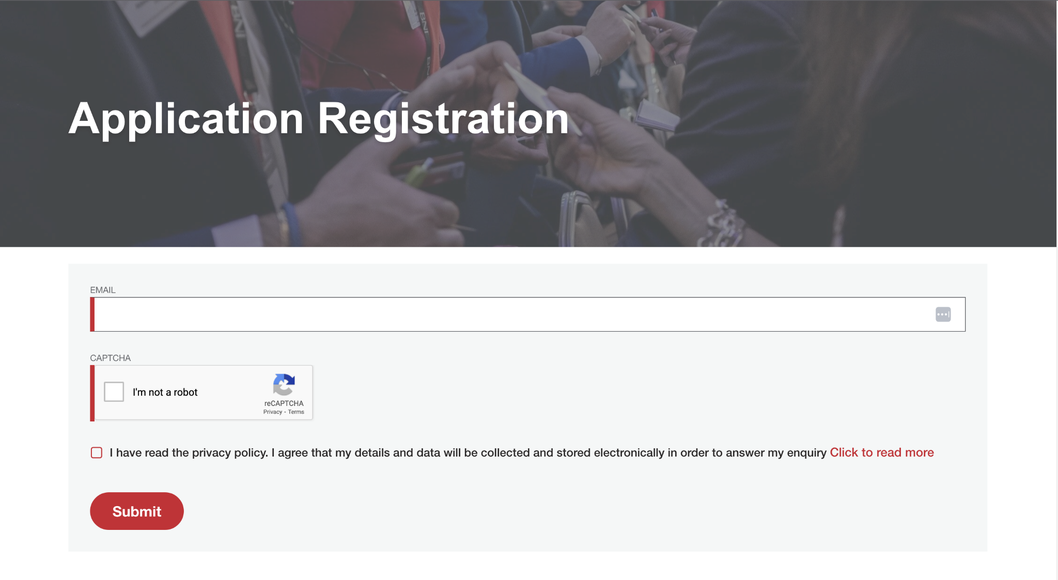

Slide 104
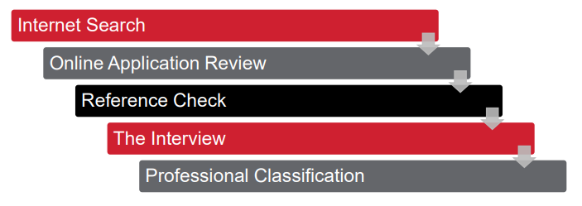
Upon receiving an application, take the following steps to ensure the applicant is a high-quality business professional before accepting them as a Member.

Slide 105
To maintain a high standard of applicants that are accepted into a BNI Chapter, please use the provided list of resources for the Membership Committee to conduct additional research for certain professions, as well as general resources for all businesses.

Slide 106
General Resources
Member’s Business Website
  Is it professional?
  Is it accurate and up to date?
  Is it a good representation of their business?
Google, www.google.com
  What kudos, awards or achievements have they accomplished?
  What other organizations are they involved in?
  If negative information is found, please confirm with photo identification.
Social Media Networks
  What image is the applicant portraying on various social media networks?
  Facebook, www.facebook.com
  LinkedIn, www.linkedin.com
  Twitter, www.twitter.com
Better Business Bureau, http://www.bbb.org/
Chambers of Commerce
Secretary of State
Licenses, Permits & Registrations

Slide 107
Industry Specific Resources
  Attorneys
    National Lawyer Regulatory Data Bank
    Select the Directory of Lawyer Disciplinary Agencies
  Building Contractors, General Contractors, Sub Contractors
    Search for local, state, national licenses
  Certified Public Accountants (CPAs)
    National Association of State Boards of Accountancy
  Financial Planners
    Financial Industry Regulatory Authority
  Insurance
    Search for local, state, national licenses
  Medical/Health Professionals
    Search for local, state, national licenses
  Mortgage
    National Mortgage Lenders Search
  Real Estate Agents
    Search for local, state, national licenses

Slide 108
Personal Information:
  The way the applicant’s entire name, business name and address on their application is how their information will appear on their BNI Connect Member Profile and respective Chapter reports. o Website, Email, Business
Membership Term:
  Applicants may choose between a 1 year and a 2-year term. They are also asked to indicate if Company paid, the name of the person or company paying the membership and whether or not they have a BNI Certificate of Credit.
Experience & Credentials:
  Is the applicant’s experience and education relevant to the category in which they are applying?
Standard and Expectations:
  This section allows us to set Member expectations up front! The more an applicant knows now, the more successful Member they will become!
Business References:
  Two Clients
    Not Boss, Supervisor, Regional or same company

Slide 109
Reference Check Questions
To assure the quality of new Members to our organization, the Membership Committee must check two business references that can vouch for the individual’s business excellence.
How long have you known the applicant in a business capacity?
What is your business relationship with the applicant?
Overall, describe HOW the applicant conducts business regarding their products or services offered?
Are you aware of any grievances by anyone regarding the products/services offered by the applicant?
Does the applicant keep and follow up on commitments?
Would hire/work with the applicant again? Why?
Do you have anything to add on behalf of the applicant?
Reference check are not optional

Slide 110
Let’s help to set the expectations of membership when interviewing an applicant. Keep in mind that this is just a place to start the conversation. You can add any questions you feel are pertinent or applicable to your Chapter’s needs.
Why did you decide to apply to BNI, specifically our Chapter?
What would you say are the strengths you bring to BNI and our Chapter?
What do you expect to receive from BNI and from our Chapter?
Will the [7:00 am] start time pose any
  Online or In Person?
  Are you able to stay for the full duration of the meeting each week?
BNI has a clearly defined attendance policy. I’d like to review it with you now, so you have a clear understanding of the policy. You are allowed up to three absences within a rolling six-month period. If you have four absences during that time, you will be asked to leave the Chapter. If you have a substitute, you are not considered absent. A substitute does not have to be from your office/business. They can be anyone willing to attend the meeting and speak on your behalf at the meeting. Do you have questions about this attendance policy? Are you willing and able to commit to this?
If you cannot attend a meeting, will you be able to have a substitute present?
Annually, our Chapter holds a special event that focuses on increasing referrals for our Members. Are you willing to send invitations to people you believe would benefit from an increase in referrals? [Mandatory for new forming Chapters and Chapters that have an upcoming Visitors’ Day.]
In reviewing your application, we want to make sure we understand what niche you will be representing in our Chapter. What specific products and services do you offer in your industry? Is there an area in which you specialize?

Slide 111
Is a license required to practice your profession in this state (or any neighboring states)? If so, what is your license number? Are you also bonded and insured, if required for your profession?
What do you like most about what you do regarding your profession?
Have you ever applied to another BNI Chapter? What was your experience?
Do you belong to other networking organizations? What was your experience? Do you understand BNI’s Policy of not belonging to other programs that hold members accountable to pass referrals?
All new Members are required to complete Member Success Program within the first 60 days of membership. This will be assigned to you to complete online. Will you be able to complete it?
All Members participate in our Passport to Success Mentor Program. Are you willing to dedicate time outside the weekly meeting to conduct One-to-Ones with your fellow Members as part of this business-building activity?
In the next six to 12 months you will be asked to be in a leadership role. Are you willing to consider which role may be appropriate for you and step into a leadership role when the time comes?
Are you aware that this Chapter has additional dues to cover our venue/meal/coffee? The amount is $____ per week/month/quarter and it is payable to the Secretary/Treasurer upon acceptance of your Membership Application.
You may have noticed on your application that upon your acceptance to BNI, fees are nonrefundable without exception. Your application has not yet been accepted. Is there any part of the application review process that has made you aware that this organization may not be a good fit for you or your business?
What reservations do you have about membership in BNI?
Do you have any questions for me about BNI or our Chapter?

Slide 112
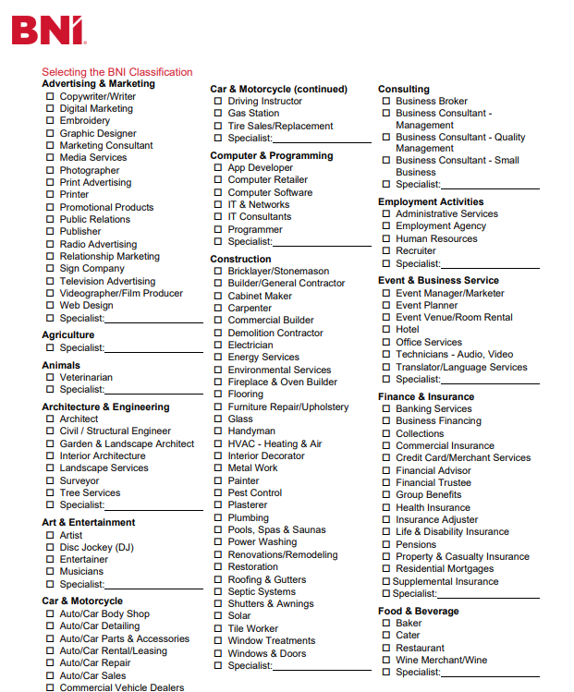
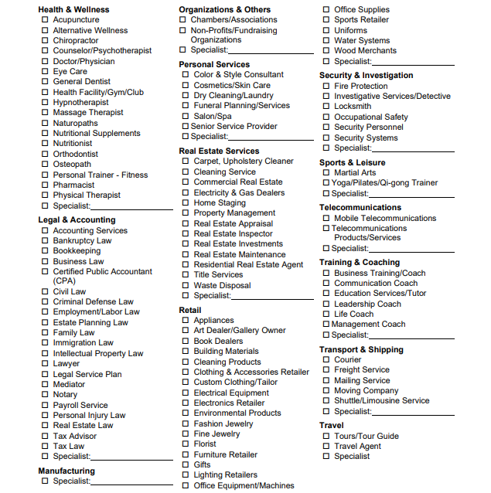

Slide 113

The following are several suggested guidelines for declining an application. This list is not meant to be either exhaustive or binding.
There is an unacceptable overlap in BNI Classification between a prospective Member and a current Member (as determined by the Membership Committee).
The profession of the prospective Member listed on the application is not his/her primary focus.
One or more objections have been filed by Members regarding the prospective Member’s type of service, quality of product or service, business ethics or professionalism.
The prospective Member does not possess the proper credentials for his/her profession (where applicable), i.e., required licensing or other certification.
The prospective Member is also a Member of another competing organization that has only one person per profession.
The prospective Member-provided incomplete or inaccurate information on the membership application, i.e., no references or failed to answer the questions listed. The prospective Member is unable to service and/or provide referrals in the community where the Chapter is located.
Poor attitude; wrong dynamics for the Chapter.

Slide 114
The Application Process
Membership Committee
Receive Application
Review & Assign Tasks
Membership Committee
Receive Application
Do Business Check
Vice President
Application Approved
Inform about Payment
Membership Committee
Receive Application
Interview References
Membership Committee
Receive Application
Accept/Deny Application
Vice President
Application Approved
Notify President
Membership Committee
Receive Application
Interview Applicant
Vice President
Application Approved
Call Applicant & Welcome
Vice President
Application Approved
Notify Mentor Coordinator

Slide 115
Member Engagement
Participation
Notes:
Update this slide deck each week. Hide (don’t delete) slides that aren’t used (ie When no new or renewing members, hide that slide). Be sure to add new members in the Weekly Presentation slides, update Feature Presenter(s), update VP Report slide, etc.
During the first 15 minutes of the meeting (known during in-person meetings as the Open Networking time) members should be encouraged to use the CHAT to network. Leadership Team and chapter members will conduct audio testing and troubleshoot connections as needed during this time.

Slide 116
Member Engagement Tips:
Keeps track of upcoming Seven-Month Reviews
Assigns Seven-Month Review to a Membership Committee member
Supports Members in the online renewal process in BNI Connect
Review the Member Traffic Lights based on the Power of One to identify the three Members who need support and coaching
Perform Coaching Moments as needed

Slide 117
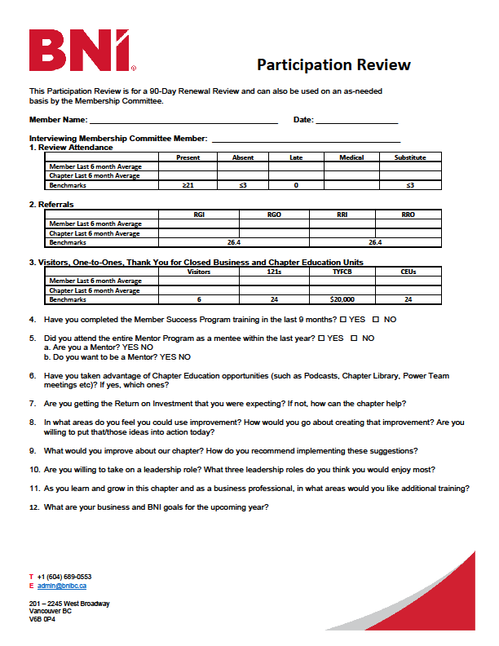
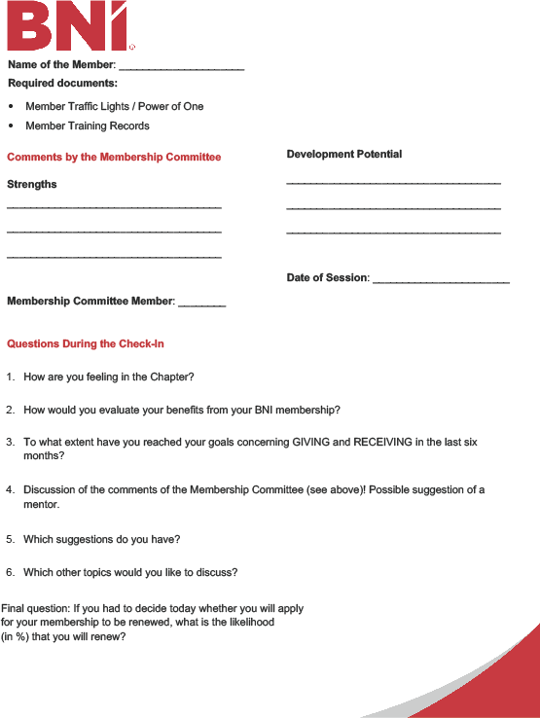

Slide 118
What to Focus On:
Getting them Trained: Member Success Program
Getting them Engaged: Mentoring (Passport) Program
Checking In:
  Mentor Coordinator: 5 - Month Review
  Membership Committee: 7-Month Review
  Membership Committee: 90 Day Renewal
Getting them Renewed: Membership Committee

Slide 119
Why 7th Months?
The Goal of the Seven-Month Check-In is to:
    Clarity for the Member about his/her development in the Chapter from a personal point of view and from the point of view of the Membership Committee
    Clarity for the Member about his/her strengths and development potential
    Providing the possibility of corrective changes before the membership renewal date
    Terms and conditions for membership renewal are clarified
    Increased renewal rate (RETENTION)

Slide 120
7 Month Process
Discussion of the Members that are due to renew in the following six months in the monthly Chapter Success Meeting:
Membership Committee determines strengths and development potential based on the PALMS Report, Member Training Report and observable attitude and performance.
If needed, the Membership Committee appoints a mentor to support the needed development of the Member.
The comments of the Membership Committee are the basis for discussion and will be noted in the Seven-Month Check-in Form.
A member of the Membership Committee who has good rapport with the Member is going to conduct the feedback session.

Slide 121
What to say during 7 Month Check-In
How are you feeling in the Chapter?
How would you evaluate your benefits from your BNI membership?
To what extent have you reached your goals concerning GIVING and RECEIVING in the last six months?
Discussion of the comments of the Membership Committee
What suggestions do you have?
What other topics you would like to discuss?
Final question: If you had to decide today whether you will apply for your membership to be renewed, what is the likelihood (in %) that you will renew?

Slide 122
90 Day Review - Criteria for Review:
Evaluation Criteria for Reviewing a Member’s Contribution:
Not bringing sufficient number of qualified referrals or visitors (or generally Traffic Lights performance).
Not attending the meeting or consistently showing up late/leaving early.
Not displaying appropriate professional behavior and/or consistently being ill prepared.
Consistently refusing to participate in the Chapter Leadership Team roles.
Additional Items to Consider:
Attitude
Attendance
Use of Substitutes
Make Use of Open Networking
Staying late to network
Follow the BNI® System
Attend BNI® Events
One-to-Ones
Follow-Up on Referrals
Thank You for Closed Business
Behavior

Slide 123
90 Day Review
Evaluate Member participation based on the Monthly PALMS Report, Summary PALMS Report in BNI Connect® and the Traffic Lights Report, as well as the actions and behaviors displayed during the BNI® Chapter Meeting
Use this information to discuss necessary courses of action during the Membership Committee Meeting
Identify and discuss ways to recognize members for their achievements
Identify and discuss strategies for members who need GROW Coaching to get them back on track to be successful by using the Monthly Take Care Report from Reporting2You
If a Member is to be placed on GROW Coaching then two Members of the Membership Committee should conduct the interviews

Slide 124
BNI Connect - Reports
Chapter Roster Report (List of Members):
Operations > Manage Visitors > Visitor Registration & Attendance Portal
Membership Dues Report (Renewals):
Operations > Meeting Management > View or Enter PALMS
Summary PALMS Report (PALMS Full Chapter Info):
Operations > Manage Memberships > View Pending Applications
Personal PALMS Report (PALMS Individual Member Info):
Operations > Manage Memberships > View Pending Applications

Slide 125
1ST YEAR OF MEMBERSHIP

Slide 126
The Timeline
Mentor Coordinator
1st Year Membership
Confirm MSP Completed
Mentor Coordinator
5-Month Review
Meet with Member
Membership Committee
Votes on Membership Renewal prior to 15th
Mentor Coordinator
1st Year Membership
Confirm Passport Complete
Membership Committee-PC
7-Month Review
VP & Member
VP Approves in System
Member Pays Renewal
Mentor Coordinator
Passport Completion
Passport Complete Ceremony
Membership Committee-PC
90 Day Renewal Review
President
First Anniversary
Recognizes Renewal

Slide 127
Community Builder
Growth & Attendance
Notes:
Update this slide deck each week. Hide (don’t delete) slides that aren’t used (ie When no new or renewing members, hide that slide). Be sure to add new members in the Weekly Presentation slides, update Feature Presenter(s), update VP Report slide, etc.
During the first 15 minutes of the meeting (known during in-person meetings as the Open Networking time) members should be encouraged to use the CHAT to network. Leadership Team and chapter members will conduct audio testing and troubleshoot connections as needed during this time.

Slide 128
Attendance
Key Attendance Functions in BNI Connect
Why is attendance crucial to the chapter?
(just checking if you’re paying attention)
What does the system do?
The BNI System sends out emails recording when absences go on and when absences come off.
How do we access the information?
The Vice President should be sharing any attendance issues with the Membership Committee, starting with the 2nd absence
and beyond.
Notes:
Yes the automated emails are great aren’t they! How many of us use systems in our business and love them? We all do!! But we can’t forget about the personal touch. While systems are great, we should still be following up with our fellow referral partners to see how they are doing. Maybe they aren’t feeling well. Maybe the kiddos are under the weather. Tell them to have a great time on their vacation!! Or wish them luck with a client or other responsibility. Just a quick little text should do the trick. They will know you and the others miss them and are thinking about them. GOLD in relationship building.
You could even ask them if they ever need assistance checking on where they are with attendance, you’d be happy to help! Then direct them to the website and the appropriate report. LOTS of care and a pinch of accountability.

Slide 129
Attendance
How Membership Committee is Involved
3. The Membership Committee should check in on members:
“We missed you at the meeting, is everything ok?”
4. What does Membership Committee do with the information?
Check in with the members during the 2nd, 3rd and 4th absences.
5. Probation and Opening of a Classification
On the third absence, a probation letter must be emailed to the
member letting them know of the probationary terms. On the fourth
absence the classification is opened up for new applicants.

Slide 130
Growth
How Membership Committee fits into Growth
The Membership Committee needs to bridge the gap between the visitor hosts and applications:
Check-in with the Visitor Host Coordinator to see if there are any potential applications coming in.
Let the rest of the Committee know of potential apps
Connect with the team if a visitor has indicated they will apply.
Follow up with Pending Applications
If a visitor submits an application, follow up and let them know
the membership committee will be vetting their app.

Slide 131
Growth
How Membership Committee fits into Growth
Other ways to help the chapter to find potential visitors:
  Check upcoming BNI Events: Regional Calendar
  Check Community Calendars for Events
Plan activities that will help the chapter with Growth:
  Request Visitor Education during EC Moments
  Request training from the Director Team
Notes:
BNI SD Events ACTivate, Member Extravaganza, Winter Olympics, Summer Olympics coming soon. You will be the champion of these events. You’ll want to do EC moments, use social media, text and other forms of communication to keep everyone on the same page and on their toes. Hold your referral partners accountable to participate. Be a cheerleader!! Be THE cheerleader. Give them tools, offer podcast, templates, etc.

Slide 132
Growth - marketing
Where are new potential referral partners finding you?
Ads, Flyers, etc…
Meet Up
Social Media (Facebook, Instagram, Tik Tok)
LinkedIn
Reach out to Other BNI Members
Where else can you tell people about BNI?
BNI Chapter game!

Slide 133
Member Relations
(Conflict/Resolution)
Notes:
Update this slide deck each week. Hide (don’t delete) slides that aren’t used (ie When no new or renewing members, hide that slide). Be sure to add new members in the Weekly Presentation slides, update Feature Presenter(s), update VP Report slide, etc.
During the first 15 minutes of the meeting (known during in-person meetings as the Open Networking time) members should be encouraged to use the CHAT to network. Leadership Team and chapter members will conduct audio testing and troubleshoot connections as needed during this time.

Slide 134
What are the stages of conflict/resolution in the Chapter?
Stage 1: Give both referral partners a chance to communicate the issue on their own.
Stage 2: The Membership Committee can moderate a conversation between members if no progress was made in stage
Stage 3: The Member can Elevate the conflict to a Written Complaint. If this happens then?
  Bring in the Area Director & Regional Team ASAP!
  MC will interview the members separately.
  Evaluate and make a decision on next steps.
  Communicate resolution with both referral partners.
  Communicate the outcome with leadership

Slide 135
The 3 rules of the Membership Committee Club
The first rule of Membership Committee Club:
Don’t talk about Membership Committee Club!
The second rule of Membership Committee Club:
Don’t talk about Membership Committee Club!
The third rule of Membership Committee Club:
Treat your members the way they want to be treated.

Slide 136
What is discussed in Membership Committee
Stays in Membership Committee!

Slide 137
The Renewal Process
Timeline Prior to Membership Expiry

Slide 138

BNI Connect
Streamline Renewals
The steps:
A member is put into pending renewal with tentative approval status 60 days before the renewal date.
Independent of application submission, LTs review and enter approve/decline decision in Connect up until 14 days prior to renewal date
Renewals with no LT decision will be auto-approved 14 days prior to the renewal date

Slide 139

VP/MC Steps
R-60
In the 60-15 day window prior to renewal…
VP/MC can render their decision in BNI Connect about the renewal at any time INDEPENDENT of application submission
If a member submits an app before the decision, an email is sent to VP to go and approve
If an approval is recorded with no app, an email is sent to member to submit renewal
If a decline is rendered with no app, the member is blocked from submitting an app - the renewal link does not appear for them and they get an error message if they try a direct link.
R-15

Slide 140
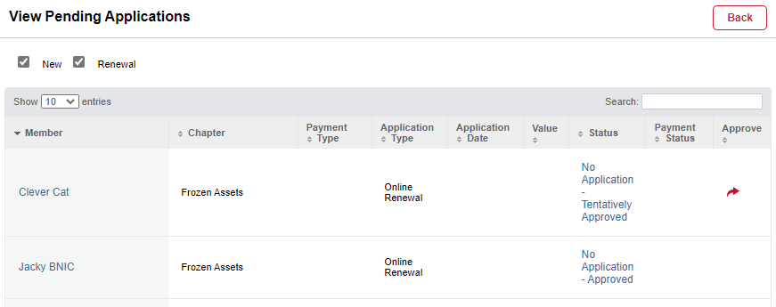
Operations > Chapter > Manage Memberships

Slide 141
View Pending Applications
R-60 to R-15 Can Decline/Renew

Slide 142
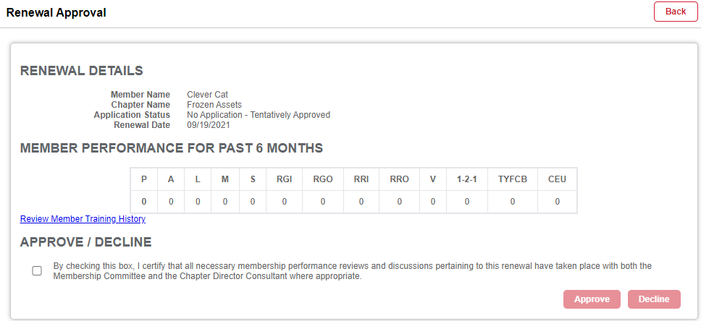
Approval Decision Screen

Slide 143
View Pending Applications
R-14 to R+15 Auto Approved

Slide 144
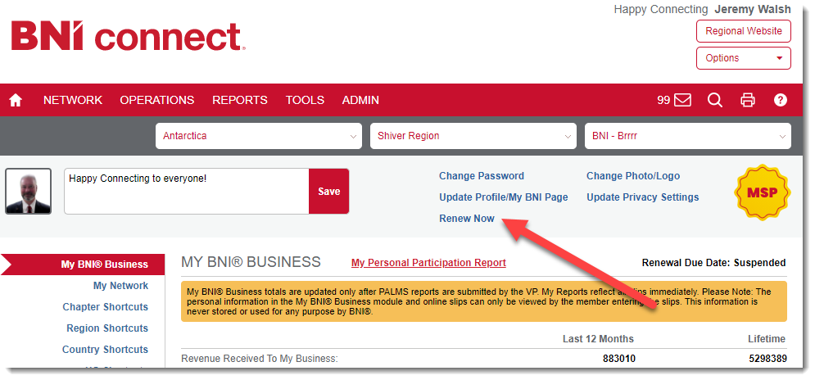
Application Submission Process
Renewals are done in the same way as legacy online renewals
Renewals are not currently available in the mobile app
You can still use the same link to send to a member to renew (https://www.bniconnectglobal.com/web/secure/appsMembershipRenewalForm)
Members CAN still renew early to take advantage of an upcoming change in dues

Slide 145
Application Submission Process

Slide 146


After Submission…
IF already approved, either by the VP/MC or automatically, the member will be taken immediately to the payment screen.
IF not already approved (any time before R-15) then a notification will be sent to the VP to approve the member. Once approved, a notification is sent to the member to finalize payment.
After payment type is selected, the regional admin is notified to review the payment and reconcile as needed.

Slide 147

Important Change Notice!
When using Streamline Renewals, membership dates are now only changed AFTER RECONCILE
This means….
…on the renewal date, members with an unpaid transaction will accrue an automatic late fee
…after the late period, the member will go into Expired and Dropped as per the business rule timing and LOSE ACCESS

Slide 148

Business Rule Update!
Membership status change timing will be automatically updated as part of this process
1 Day LATE
15 Days EXPIRED
32 Days DROPPED

Slide 149
If your member doesn’t renew and pay on time…
2
On Day 2 of the month…
The member will be LATE.
The member can still log in and renew.
A late fee is automatically applied
The late fee cannot be waived at this point by the region.
Late fees can be waived by support, but it requires a support ticket.

Slide 150
If your member doesn’t renew and pay on time…
16
On Day 16 of the month…
The member will be EXPIRED
The member cannot log in and loses access to BNI Connect, BNI Business Builder and the mobile apps
The region can still input an old school “paper” offline renewal to reactivate them
OR support can give them a temporary membership loan to allow them to log in
For reporting and stats, this is considered a -1 member

Slide 151
If your member doesn’t renew and pay on time…
33
On Day 33 of the month…
The member will be DROPPED
The membership record is closed and requires a new application (*they will lose their continuous history and slips)
OR support can reactivate and give them a temporary membership loan to allow them to log in.

Slide 152

Processes
61+ days before renewal:
Member Submits App >
VP/MC Approves App >
Member is sent payment link

Slide 153
Processes
BETWEEN 60 and 15 days before renewal:
Member Submits App >
VP/MC Approves App >
Member is sent payment link
OR
VP/MC Approves App >
Member Submits App with no changes that require approval >
Member immediately taken to payment option
OR
VP/MC Approves App >
Member Submits App requiring new approval >
VP/MC Approves App >
Member is sent payment link

Slide 154
Processes
BETWEEN 14 days before renewal up until 15 days past renewal date
Member is automatically fully approved by system >
Member Submits App >
Member immediately taken to payment option
OR
Member had previously submitted app >
Member is automatically fully approved by system >
Member is sent payment link

Slide 155
What are all those emails?

Slide 156
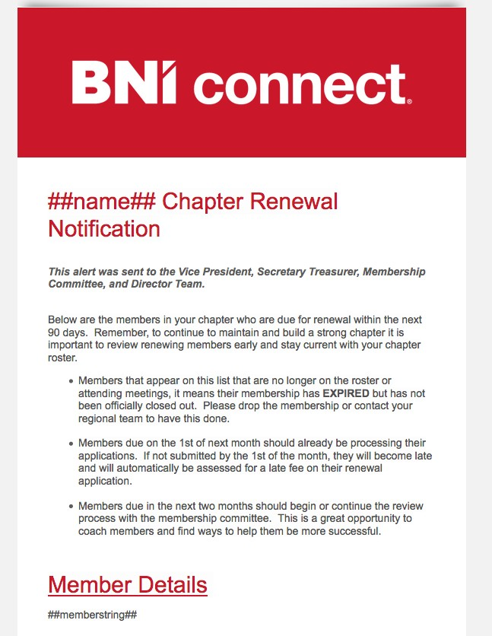
Renewal Reminder to Leadership Team

Slide 157
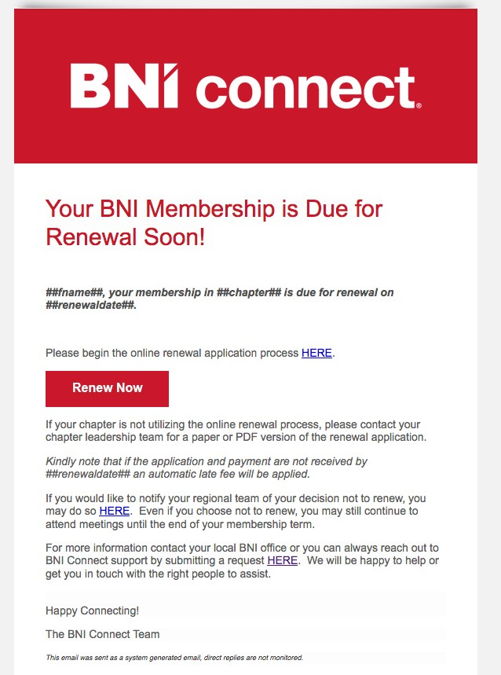
Renewal Reminder to Member

Slide 158
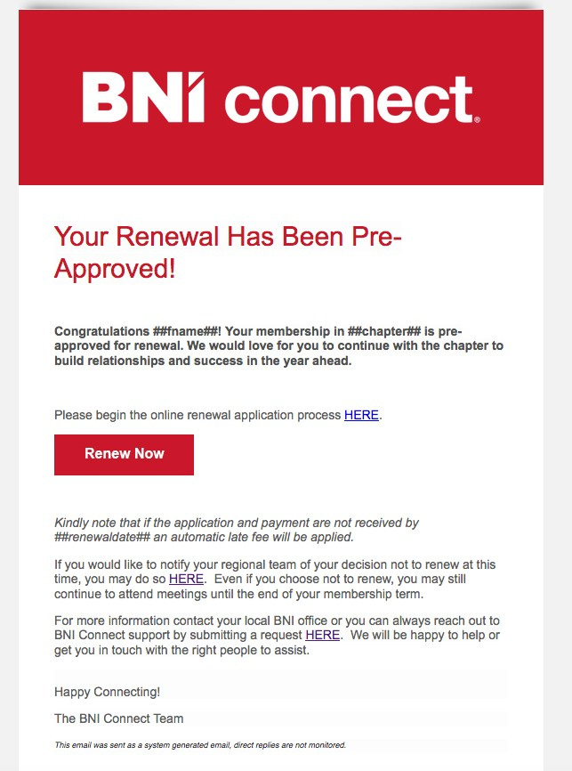
Notice of Pre-Approval to Member

Slide 159
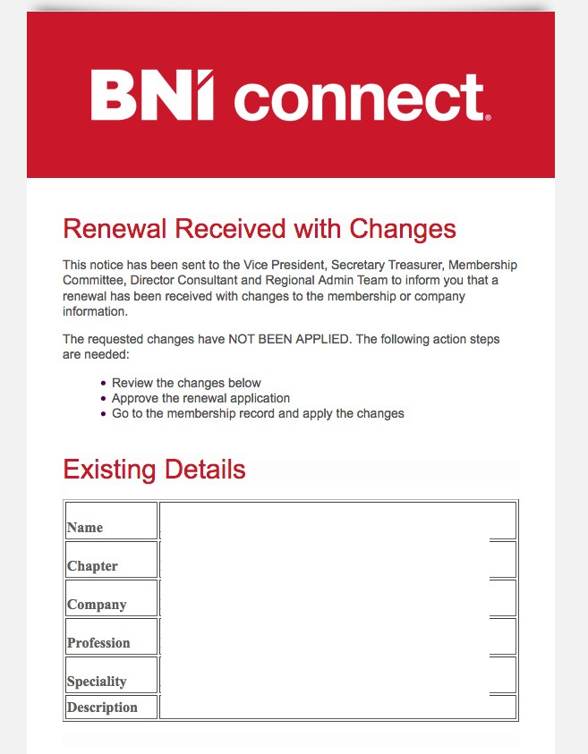
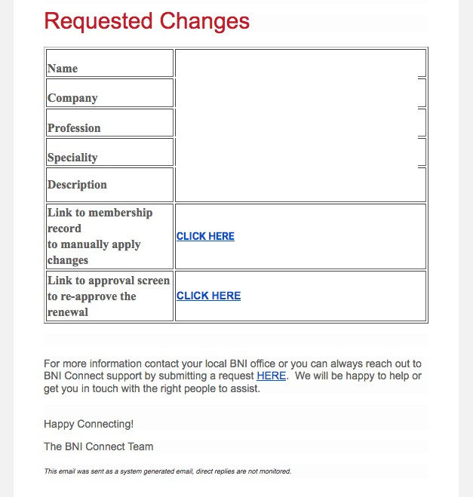
Renewal with Profile Changes

Slide 160
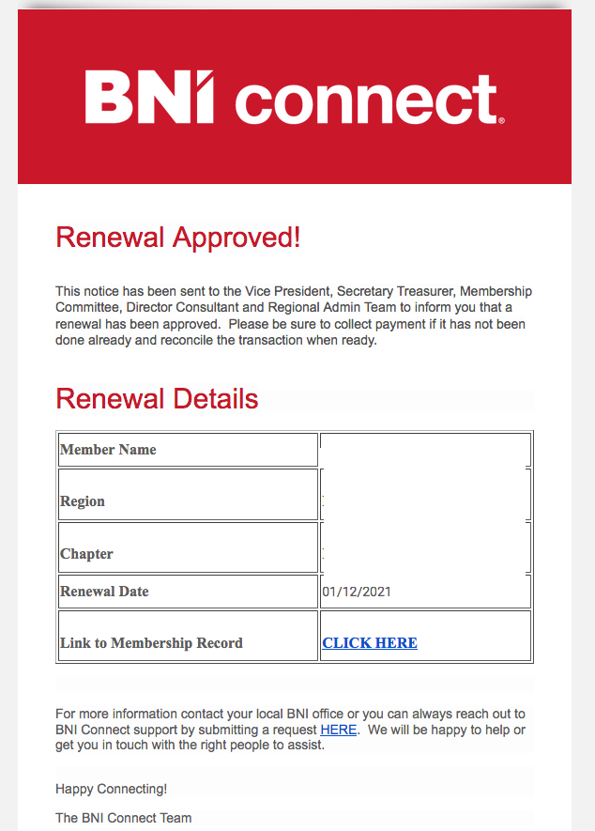
Renewal Approved

Slide 161
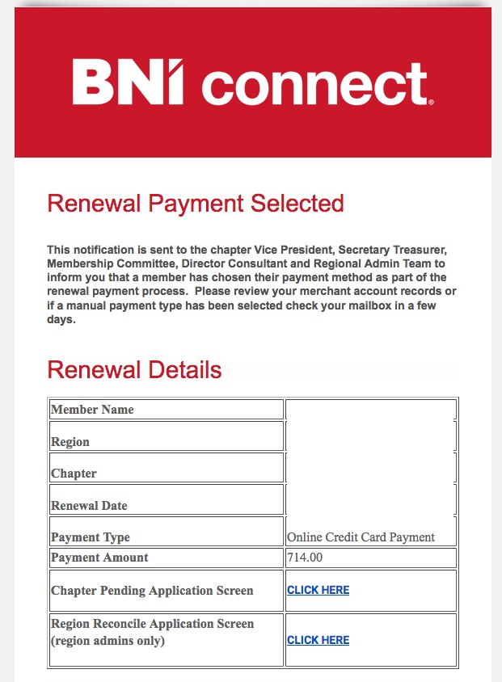
Confirmation of Payment / Reconciliation Request

Slide 162
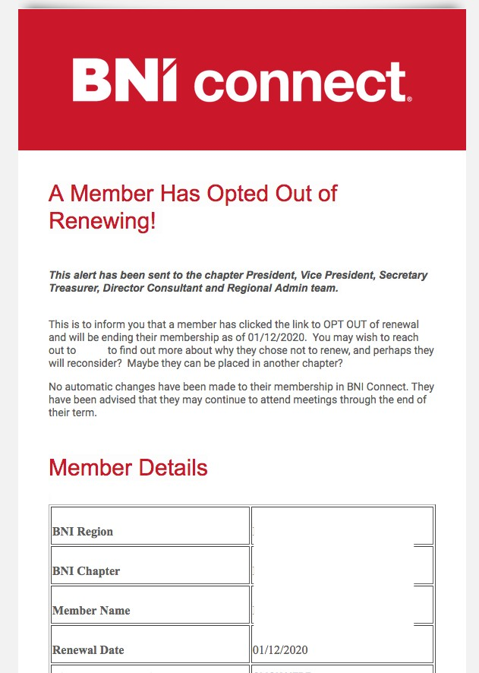
Alternate Outcomes for Renewal
Membership Committee Approves Renewal with Conditions
Membership Committee Declines Renewal
Member opts out of Renewal

Slide 163
Chapter Success Meeting
All Leadership Teams must coordinate with their Chapter Director Consultant to set the dates & times for the full year
The Vice President and all Membership Committee members must attend the full CSM each month
(The President, Secretary-Treasurer, Visitor Host Coordinator & Mentor Coordinator attend the first half only.)
Please make sure that the Chapter CSM form is filled out monthly and emailed to your DC, AD, and ED.

Slide 164
Where do I go for help?

Slide 165
The Leadership Team Resource Page
BNISouthCentralIN.com

Slide 166
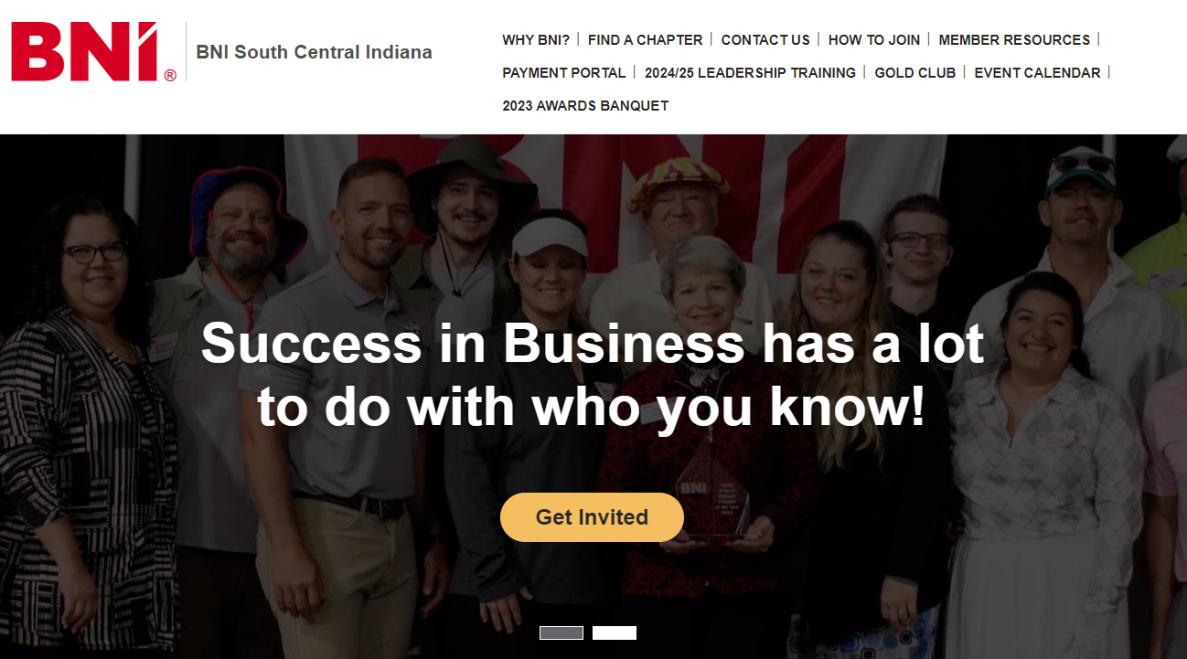
The Leadership Team Resource Page

Slide 167
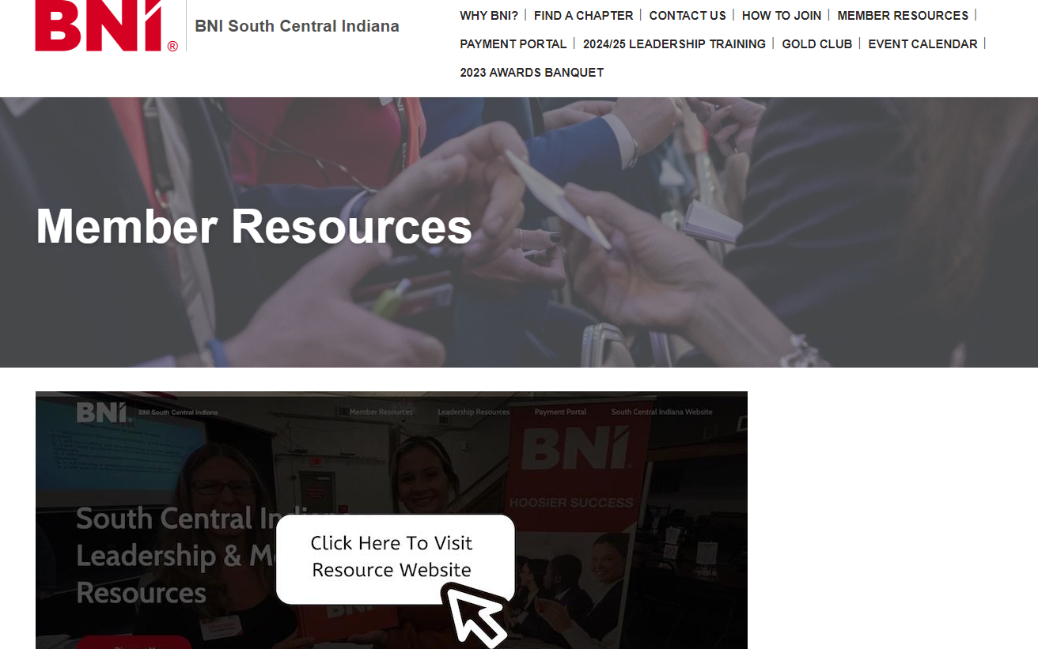
The Leadership Team Resource Page

Slide 168
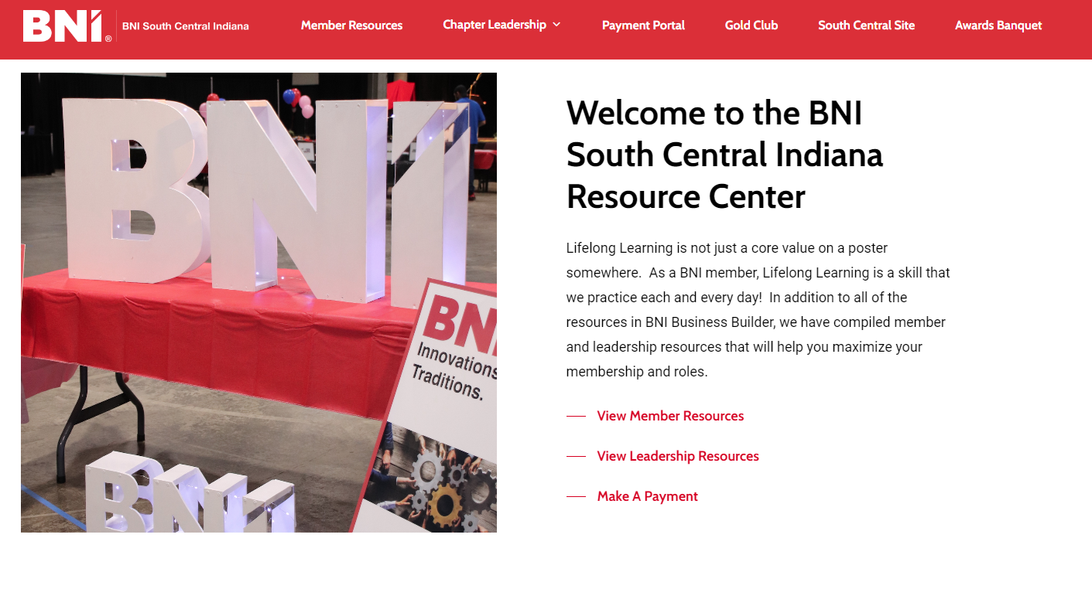
The Leadership Team Resource Page

Slide 169
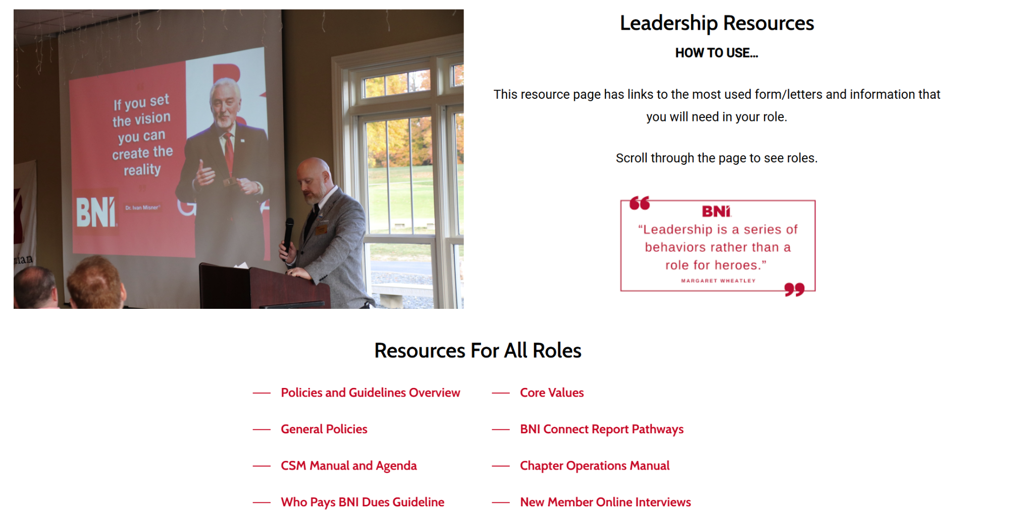

Slide 170
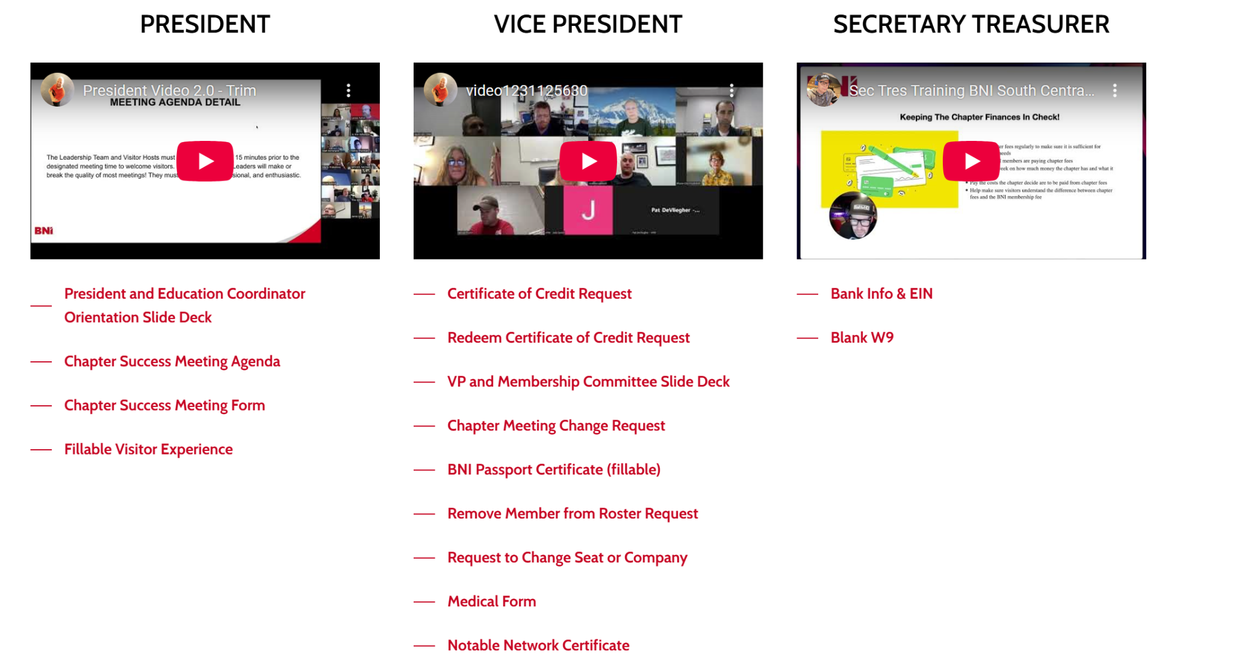

Slide 171
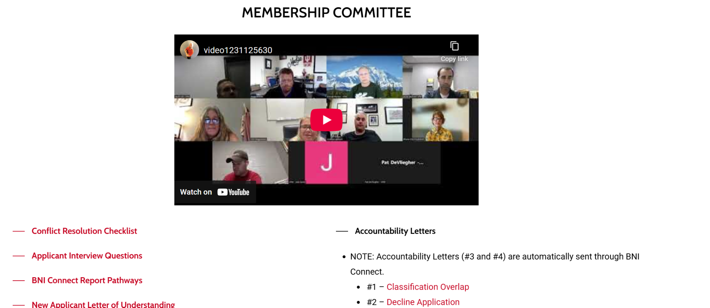

Slide 172
4 CEU

Slide 173
Closing Quote
"The price of greatness is responsibility."
- Winston Churchill

Slide 174
Thank you!

